Slide 1
Declaration of Terpsehore P Maras
Pursuant to 28 U.S.C Section 1746, I, Terpsehore P Maras, make the following declaration.
I am over the age of 21 years and I am under no legal disability, which would prevent me from giving this declaration.
I have been a private contractor with experience gathering and analyzing foreign intelligence and acted as a LOCALIZER during the deployment of projects and operations both OCONUS and CONUS. I am a trained Cryptolinguist, hold a completed degree in Molecular and Cellular Physiology and have FORMAL training in other sciences such as Computational Linguistics, Game Theory, Algorithmic Aspects of Machine Learning, Predictive Analytics among others.
I have operational experience in sources and methods of implementing operations during elections both CONUS and OCONUS
I am an amateur network tracer and cryptographer and have over two decades of
mathematical modeling and pattern analysis.
In my position from 1999-2014 I was responsible for delegating implementation via other contractors sub-contracting with US or 9 EYES agencies identifying connectivity, networking and subcontractors that would manage the micro operations.
My information is my personal knowledge and ability to detect relationships between the companies and validate that with the cryptographic knowledge I know and attest to as well
as evidence of these relationships.
In addition, I am WELL versed due to my assignments during my time as a private contractor of how elections OCONUS (for countries I have had an assignment at) and
CONUS (well versed in HAVA ACT) and more.
On or about October 2017 I had reached out to the US Senate Majority Leader with an
affidavit claiming that our elections in 2017 may be null and void due to lack of EAC certifications. In fact Sen. Wyden sent a letter to Jack Cobb on 31 OCT 2017 advising discreetly pointing out the importance of being CERTIFIED EAC had issued a certificate to

Slide 2
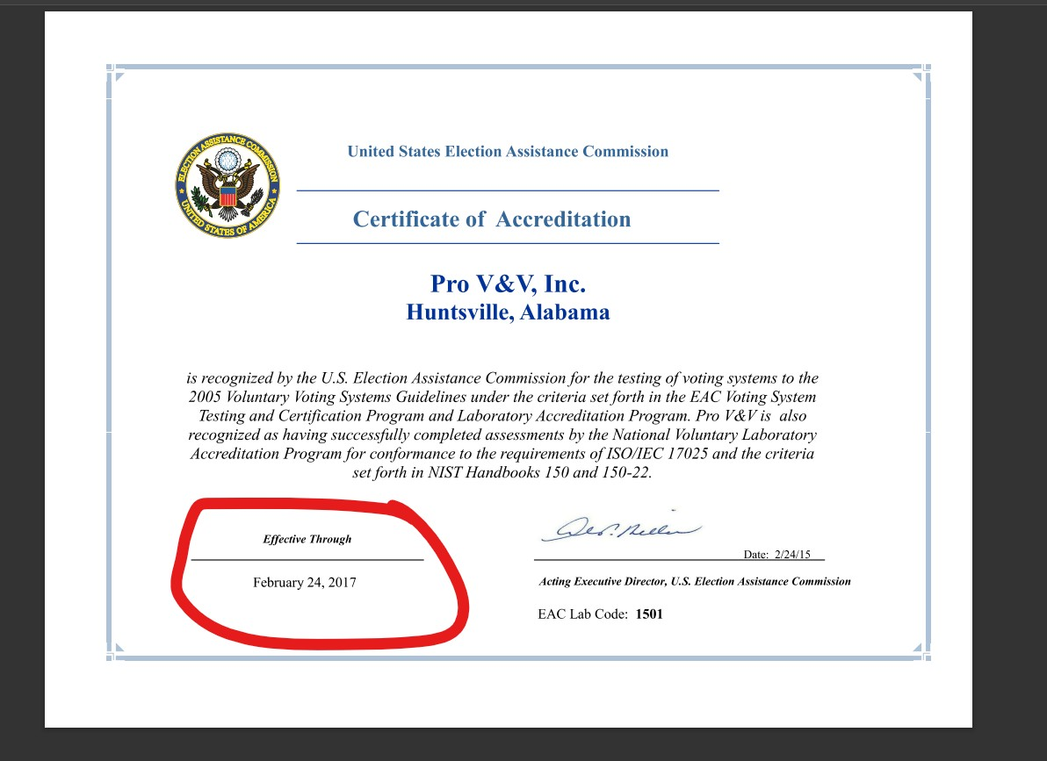
Pro V & V and that expired on Feb 24, 2017. No other certification has been located.
9. Section 231(b) of the Help America Vote Act (HAVA) of 2002 (42 U.S.C. §15371(b)) requires that the EAC provide for the accreditation and revocation of accreditation of independent, non-federal laboratories qualified to test voting systems to Federal standards. Generally, the EAC considers for accreditation those laboratories evaluated and recommended by the National Institute of Standards and Technology (NIST) pursuant to HAVA Section 231(b)(1). However, consistent with HAVA Section 231(b)(2)(B), the Commission may also vote to accredit laboratories outside of those recommended by NIST upon publication of an explanation of the reason for any such accreditation.

Slide 3
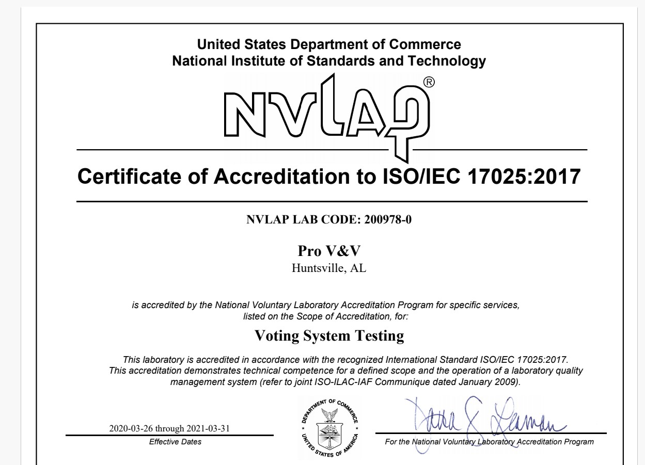
10.
VSTL’s are VERY important because equipment vulnerabilities allow for deployment of
algorithms and scripts to intercept, alter and adjust voting tallies.
There are only TWO accredited VSTLs (VOTING SYSTEM TEST LABORATORIES). In
order to meet its statutory requirements under HAVA §15371(b), the EAC has developed the EAC’s Voting System Test Laboratory Accreditation Program. The procedural requirements of the program are established in the proposed information collection, the EAC Voting System Test Laboratory Accreditation Program Manual. Although participation in the program is voluntary, adherence to the program’s procedural requirements is mandatory for participants. The procedural requirements of this Manual will supersede any prior laboratory accreditation requirements issued by the EAC. This manual shall be read in conjunction with the EAC’s Voting System Testing and Certification Program Manual (OMB 3265-0019).

Slide 4
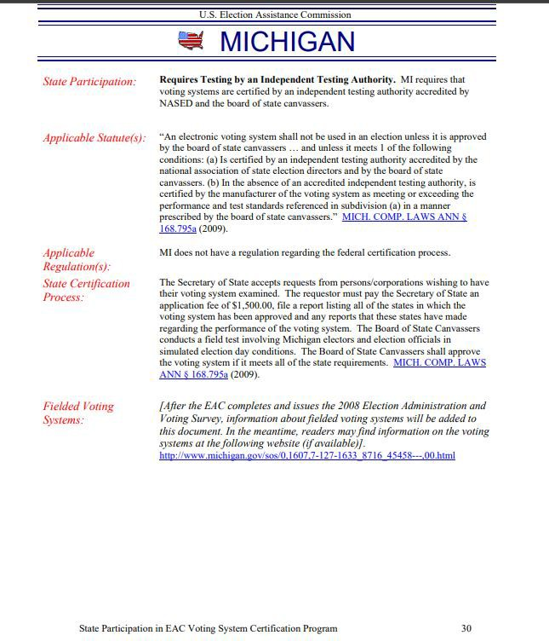
13.

Slide 5
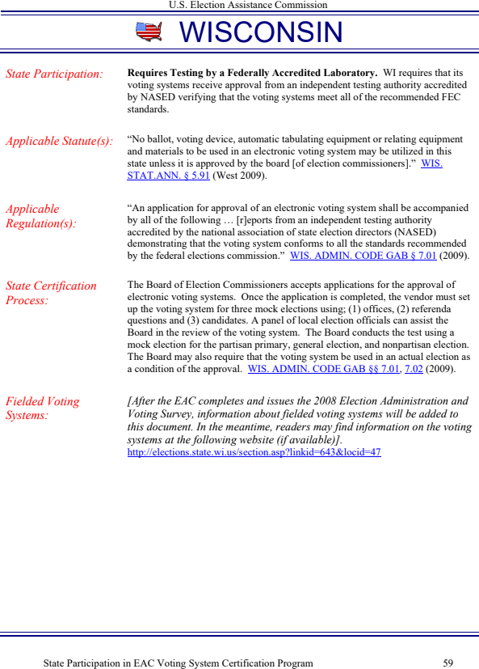
14.

Slide 6
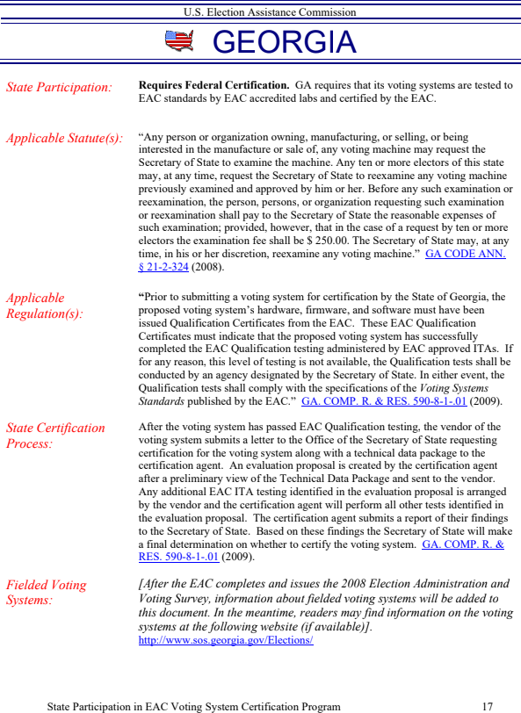
15.

Slide 7
16.

Slide 8
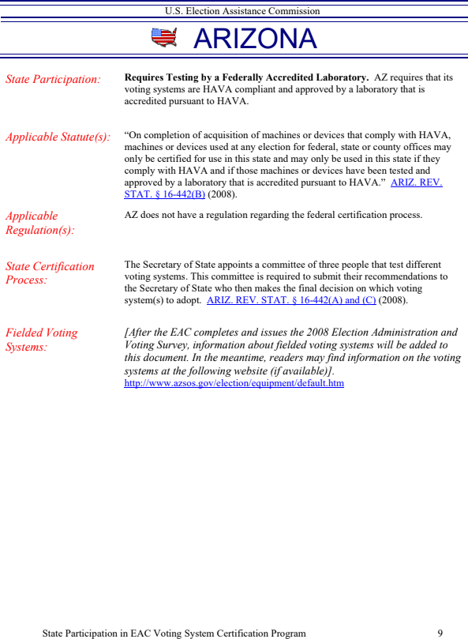
17.
18. Pro V& V and SLI Gaming both lack evidence of EAC Accreditation as per the Voting System Testing and Certification Manual.

Slide 9
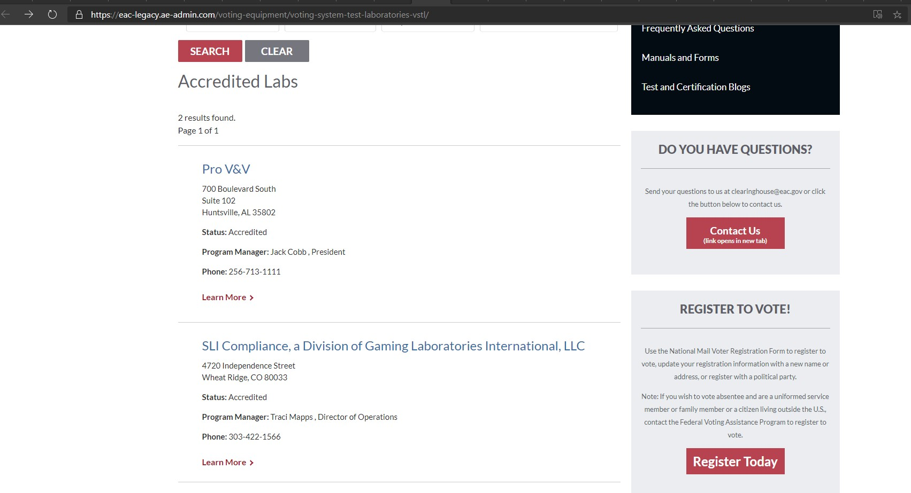
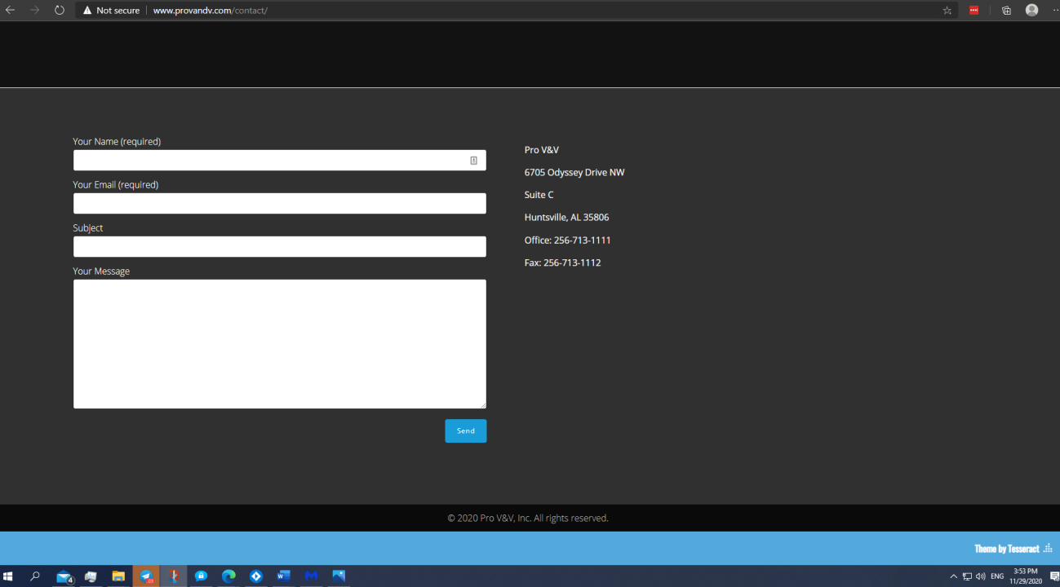
19. Pro V& V is owned and Operated by Jack Cobb. Real name is Ryan Jackson Cobb. The company
ProV&V was founded and run by Jack Cobb who formerly worked under the entity of Wyle Laboratories which is an AEROSPACE DEFENSE CONTRACTING ENTITY. The address
information on the EAC, NIST and other entities for Pro V& V are different than that of what is on ProV&V website. The EAC and NIST (ISO CERT) issuers all have another address.

Slide 10
VSTLs are the most important component of the election machines as they examine the use of COTS (Commercial Off–The-Shelf)
“Wyle became involved with the testing of electronic voting systems in the early 1990’s and has tested over 150 separate voting systems. Wyle was the first company to obtain accreditation by the National Association of State Election Directors (NASED). Wyle is accredited by the Election Assistance Commission (EAC) as a Voting System Testing Laboratory (VSTL). Our scope of accreditation as a VSTL encompasses all aspects of the hardware and software of a voting machine. Wyle also received NVLAP accreditation to ISO/IEC 17025:2005 from NIST.” Testimony of Jack Cobb 2009
COTS are preferred by many because they have been tried and tested in the open market and
are most economic and readily available. COTS are also the SOURCE of vulnerability therefore VSTLs are VERY important. COTS components by voting system machine manufacturers can be used as a “Black Box” and changes to their specs and hardware make up change continuously. Some changes can be simple upgrades to make them more efficient in operation, cost efficient for production, end of life (EOL) and even complete reworks to meet new standards. They key issue in this is that MOST of the COTS used by Election Machine Vendors like Dominion, ES&S, Hart Intercivic, Smartmatic and others is that such manufacturing for COTS have been outsourced to China which if implemented in our Election Machines make us vulnerable to BLACK BOX antics and backdoors due to hardware changes that can go undetected. This is why VSTL’s are VERY important.
The proprietary voting system software is done so and created with cost efficiency in mind and therefore relies on 3rd party software that is AVAILABLE and HOUSED on the HARDWARE. This is a vulnerability. Exporting system reporting using software like Crystal Reports, or PDF software allows for vulnerabilities with their constant updates.
As per the COTS hardware components that are fixed, and origin may be cloaked under
proprietary information a major vulnerability exists since once again third-party support software is dynamic and requires FREQUENT updates. The hardware components of the computer components, and election machines that are COTS may have slight updates that can be overlooked as they may be like those designed that support the other third -party software. COTS origin is important and the US Intelligence Community report in 2018 verifies that.
The Trump Administration made it clear that there is an absence of a major U.S. alternative to foreign suppliers of networking equipment. This highlights the growing dominance of

Slide 11
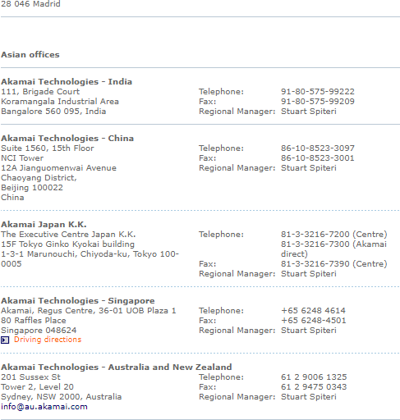
Chinese manufacturers like Huawei that are the world’s LARGEST supplier of telecom and other equipment that endangers national security.
26. China, is not the only nation involved in COTS provided to election machines or the networking but so is Germany via a LAOS founded Chinese linked cloud service company that works with SCYTL named Akamai Technologies that have offices in China and are linked to the server that Dominion Software.

Slide 12
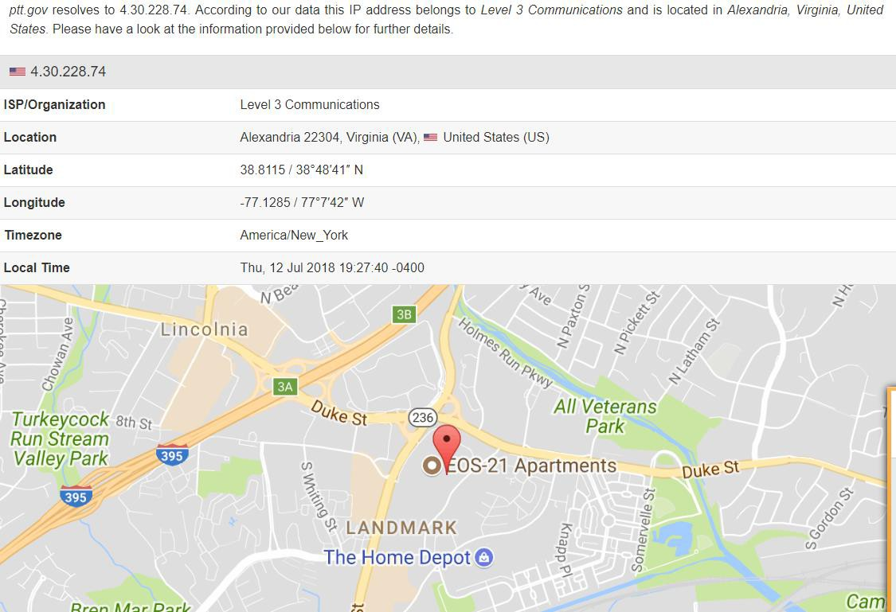
27.
28. L3 Level Communications is federal contractor that is partially owned by foreign lobbyist
George Soros. An article that AP ran in 2010 – spoke out about the controversy of this that has been removed. (LINK) “As for the company’s other political connections, it also appears that none other than George Soros, the billionaire funder of the country’s liberal political infrastructure, owns 11,300 shares of OSI Systems Inc., the company that owns Rapiscan.
Not surprisingly, OSI’s stock has appreciated considerably over the course of the year. Soros certainly is a savvy investor.” Washington Examiner re-write.

Slide 13
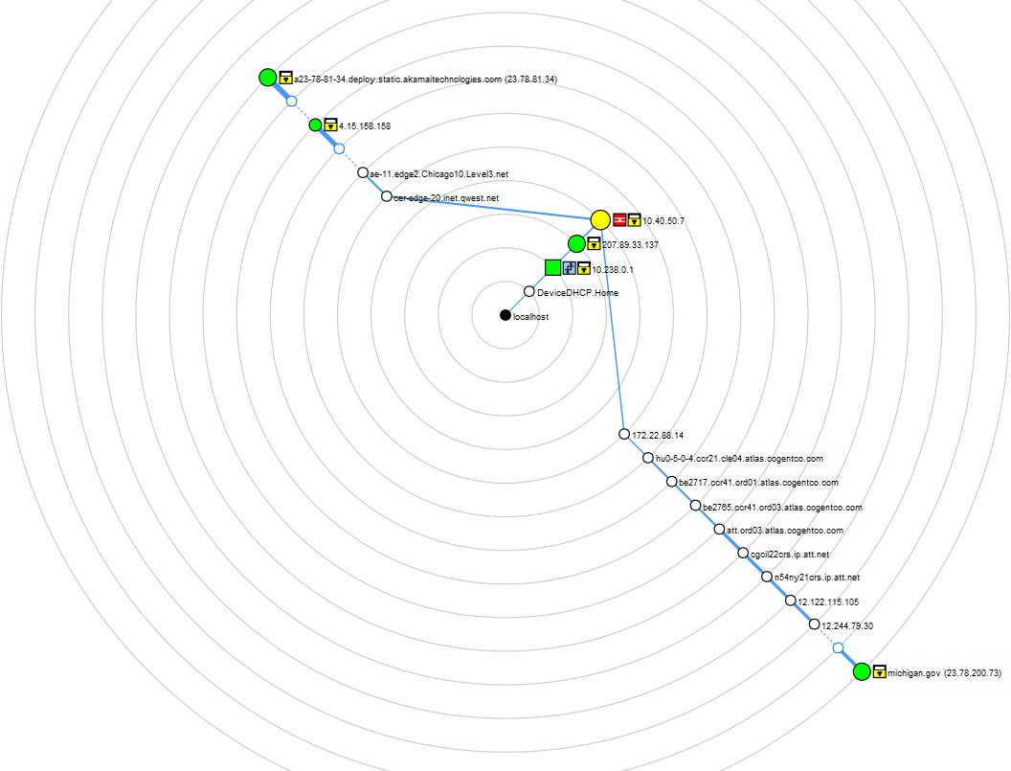
29.

Slide 14
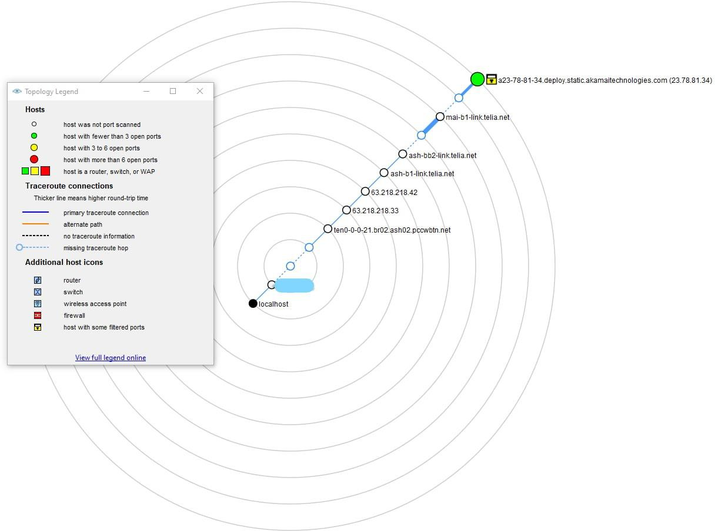
30.
31. L-3 Communication Systems-East designs, develops, produces and integrates
communication systems and support equipment for space, air, ground, and naval applications, including C4I systems and products; integrated Navy communication systems;
integrated space communications and RF payloads; recording systems; secure communications, and information security systems. In addition, their site claims that MARCOM is an integrated communications system and The Marcom® is the foundation of the Navy’s newest digital integrated voice / data switching system for affordable command and control equipment supporting communications and radio room automation. The MarCom® uses the latest COTS digital technology and open systems standards to offer the command and control user a low cost, user friendly, solution to the complex voice, video and data communications needs of present and future joint / allied missions. Built in reliability, rugged construction, and fail-safe circuits ensure your call and messages will go through. Evidently a HUGE vulnerability.

Slide 15
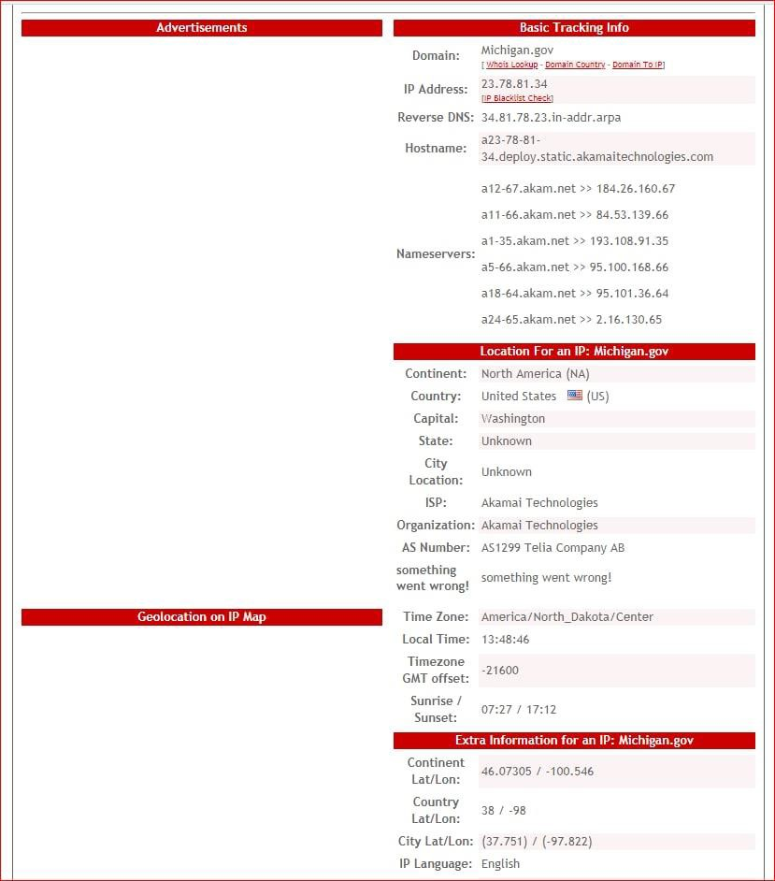
Michigan’s government site is thumped off Akamai Technologies servers which are housed on TELIA AB a foreign server located in Germany.
Scytl, who is contracted with AP that receives the results tallied BY Scytl on behalf of Dominion – During the elections the AP reporting site had a disclaimer.
AP – powered by SCYTL.

Slide 16
“Scytl was selected by the Federal Voting Assistance Program of the U.S. Department of Defense to provide a secure online ballot delivery and onscreen marking systems under a program to support overseas military and civilian voters for the 2010 election cycle and beyond. Scytl was awarded 9 of the 20 States that agreed to participate in the program (New York, Washington, Missouri, Nebraska, Kansas, New Mexico, South Carolina, Mississippi and Indiana), making it the provider with the highest number of participating States.” PDF
According to DOMINION : 1.4.1Software and Firmware The software and firmware
employed by Dominion D-Suite 5.5-Aconsists of 2 types, custom and commercial off the shelf (COTS). COTS applications were verified to be pristine or were subjected to source code review for analysis of any modifications and verification of meeting the pertinent standards.
The concern is the HARDWARE and the NON – ACCREDITED VSTLs as by their own admittance use COTS.
The purpose of VSTL’s being accredited and their importance in ensuring that there is no
foreign interference/ bad actors accessing the tally data via backdoors in equipment
software. The core software used by ALL SCYTL related Election Machine/Software manufacturers ensures “anonymity” .
Algorithms within the area of this “shuffling” to maintain anonymity allows for setting values to achieve a desired goal under the guise of “encryption” in the trap-door.
The actual use of trapdoor commitments in Bayer-Groth proofs demonstrate the implications
for the verifiability factor. This means that no one can SEE what is going on during the process of the “shuffling” therefore even if you deploy an algorithms or manual scripts to fractionalize or distribute pooled votes to achieve the outcome you wish – you cannot prove they are doing it! See STUDY : “The use of trapdoor commitments in Bayer-Groth proofs and the implications for the verifiability of the Scytl-SwissPost Internet voting system”
Key Terms
UNIVERSAL VERIFIABILITY: Votes cast are the votes counted and integrity of the vote is verifiable (the vote was tallied for the candidate selected) . SCYTL FAILS UNIVERSAL VERIFIABILITY because no mathematical proofs can determine if any votes have been manipulated.
INDIVIDUAL VERIFIABILITY: Voter cannot verify if their ballot got correctly counted. Like, if they cast a vote for ABC they want to verify it was ABC. That notion clearly discounts the need for anonymity in the first place.

Slide 17
To understand what I observed during the 2020 I will walk you through the process of one ballot cast by a voter.
STEP 1 |Config Data | All non e-voting data is sent to Scytl (offshore) for configuration of data. All e-voting is sent to CONFIGURATION OF DATA then back to the e-voting machine and then to the next phase called CLEANSING. CONCERNS: Here we see an “OR PROOF” as coined by mathematicians – an “or proof” is that votes that have been pre-tallied parked in the system and the algorithm then goes back to set the outcome it is set for and seeks to make adjustments if there is a partial pivot present causing it to fail demanding manual changes such as block allocation and narrowing of parameters or self-adjusts to ensure the predetermined outcome is achieved.
STEP 2|CLEANSING | The Process is when all the votes come in from the software run by Dominion and get “cleansed” and put into 2 categories: invalid votes and valid votes.
STEP 3|Shuffling /Mixing | This step is the most nefarious and exactly where the issues arise and
carry over into the decryption phase. Simply put, the software takes all the votes, literally mixes them a and then re-encrypts them. This is where if ONE had the commitment key- TRAPDOOR KEY – one would be able to see the parameters of the algorithm deployed as the votes go into this mixing phase, and how algorithm redistributes the votes.
This published PAPER FROM University College London depicts how this shuffle works. In essence, when this mixing/shuffling occurs, then one doesn’t have the ability to know that vote coming out on the other end is actually their vote; therefore, ZERO integrity of the votes when mixed.

Slide 18
48.
When this mixing/shuffling occurs, then one doesn’t have the ability to know that vote coming out on the other end is actually their vote; therefore, ZERO integrity of the votes.
When the votes are sent to Scytl via Dominion Software EMS (Election Management System) the Trap Door is accessed by Scytl or TRAP DOOR keys (Commitment Parameters).
SCYTL – FURTHER ENCRYPTS -
COMMITMENTS
DOMINION
51.
Ballot with votes
Encryption by Dominion
TRAP-DOOR
Encryption by SCYTL
Votes Tallied-REPORTED by Scytl
ACCESS VIA BACKDOORS IN HARDWARE
AGAIN
Temporary parking votes
Pre-tallied votes
The encrypted data is shifted into Scytl’s platform in the form of ciphertexts – this means it is encrypted and a key based on commitments is needed to read the data. The ballot data can only be read if the person has a key that is set on commitments.
A false sense of security is provided to both parties that votes are not being “REPLACED” during the mixing phase. Basically, Scytl re-encrypts the ballot data that comes in from Dominion (or any other voting software company) as ciphertexts. Scytl is supposed to prove that votes A, B, C are indeed X, Y, Z under their new re-encryption when sending back the votes that are tallied coding them respectively. This is done by Scytl and the Election Software company that agrees to certain

Slide 19
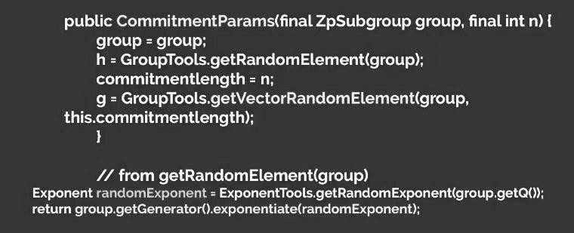
“Generators” and therefore together build “commitments.”
Scytl and Dominion have an agreement – only the two would know the parameters. This means that access is able to occur through backdoors in hardware if the parameters of the commitments are known in order to alter the range of the algorithm deployed to satisfy the outcome sought in the case of algorithm failure.
Trapdoor is a cryptotech term that describes a state of a program that knows the commitment parameters and therefore is able change the value of the commitments however it likes. In other words, Scytl or anyone that knows the commitment parameters can take all the votes and give
them to any one they want. If they have a total of 1000 votes an algorithm can distribute them
among all races as it deems necessary to achieve the goals it wants. (Case Study: Estonia)

Slide 20
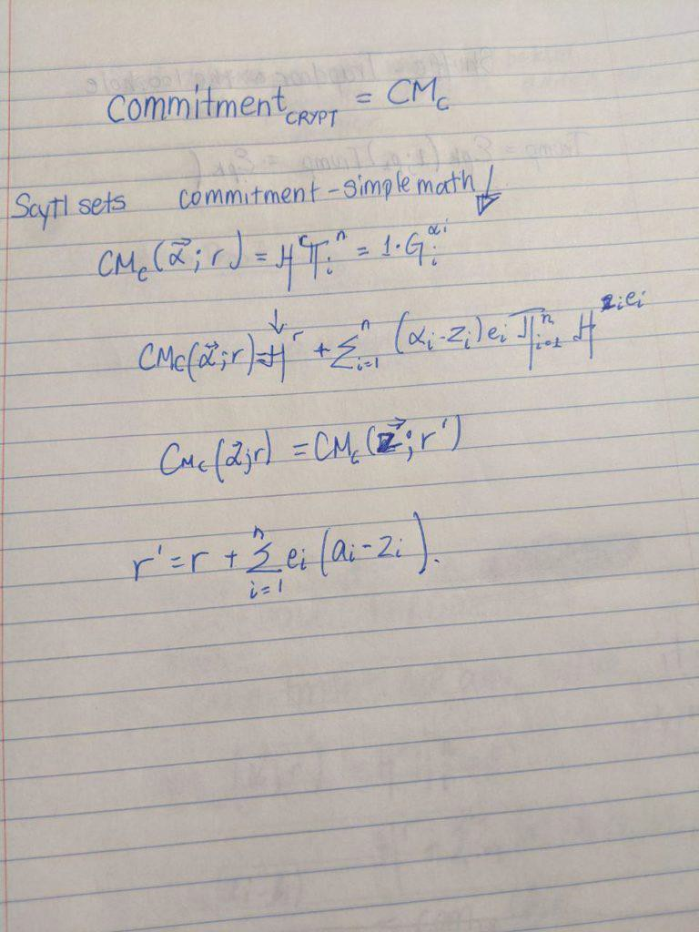
56.
57. Within the trapdoor this is how the algorithm behaves to move the goal posts in elections without
being detected by this proof . During the mixing phase this is the algorithm you would use to

Slide 21
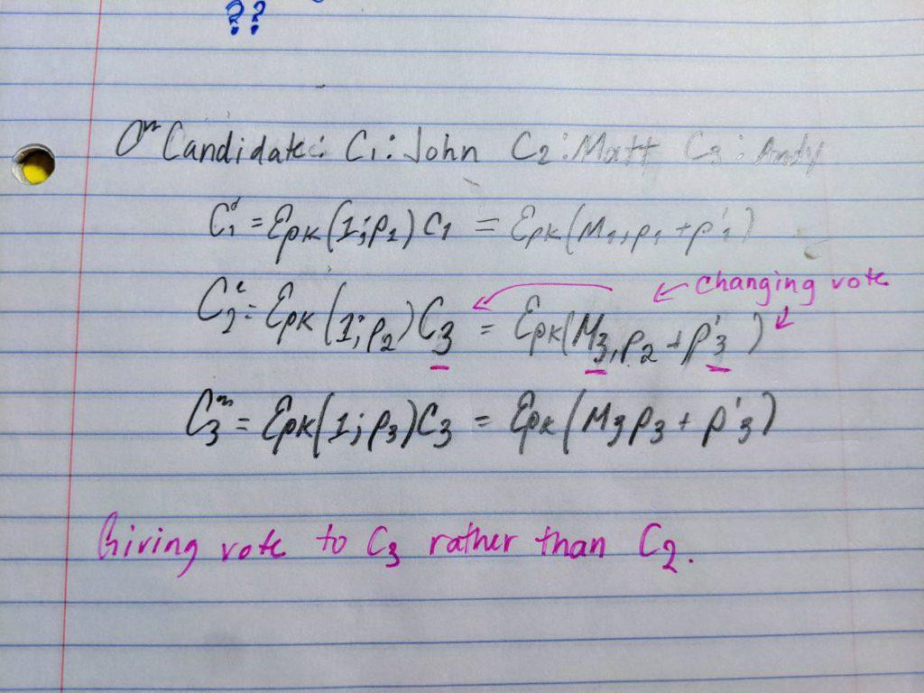
“reallocate” votes via an algorithm to achieve the goal set.
STEP 4|Decryption would be the decryption phase and temporary parking of vote tallies before reporting. In this final phase before public release the tallies are released from encrypted format into plain text. As previously explained, those that know the trapdoor can easily change any votes that the randomness is applied and used to generate the tally vote ciphertext. Thus in this case, Scytl who is the mixer can collude with their vote company clients or an agency (-------) to change votes and get away with it. This is because the receiver doesn’t have the decryption key so they rely solely on Scytl to be honest or free from any foreign actors within their backdoor or the Election Company (like Dominion) that can have access to the key.
In fact, a study from the University of Bristol made claim that interference can be seen when there is a GREAT DELAY in reporting and finalizing numbers University of Bristol : How not to Prove Yourself: Pitfalls of the Fiat-Shamir Heuristic and Applications to Helios
“Zero-knowledge proofs of knowledge allow a prover to convince a verifier that she holds information satisfying some desirable properties without revealing anything else.” David Bernhard, Olivier Pereira,and Bogdan Warinschi.

Slide 22
Hence, you can’t prove anyone manipulated anything. The TRAP DOOR KEY HOLDERS can offer you enough to verify to you what you need to see without revealing anything and once again indicating the inability to detect manipulation. ZERO PROOF of INTEGRITY OF THE VOTE.
Therefore, if decryption is challenged, the administrator or software company that knows the trap door key can provide you proof that would be able to pass verification (blind). This was proven to be factually true in the case study by The University of Melbourne in March. White Hat Hackers
purposely altered votes by knowing the parameters set in the commitments and there was no way to prove they did it – or any way to prove they didn’t.
IT’S THE PERFECT THREE CARD MONTY. That’s just how perfect it is. They fake a proof of ciphertexts with KNOWN “RANDOMNESS” .This rolls back to the integrity of the VOTE. The
vote is not safe using these machines not only because of the method used for ballot “cleansing” to maintain anonymity but the EXPOSURE to foreign interference and possible domestic bad actors.
In many circumstances, manipulation of the algorithm is NOT possible in an undetectable fashion. This is because it is one point heavy. Observing the elections in 2020 confirm the deployment of an
algorithm due to the BEHAVIOR which is indicative of an algorithm in play that had no pivoting parameters applied.
The behavior of the algorithm is that one point (B) is the greatest point within the allocated set. It is the greatest number within the A B points given. Point A would be the smallest. Any points outside the A B points are not necessarily factored in yet can still be applied.
The points outside the parameters can be utilized to a certain to degree such as in block allocation.
The algorithm geographically changed the parameters of the algorithm to force blue votes and ostracize red.
Post block allocation of votes the two points of the algorithm were narrowed ensuring a BIDEN win hence the observation of NO Trump Votes and some BIDEN votes for a period of time.

Slide 23
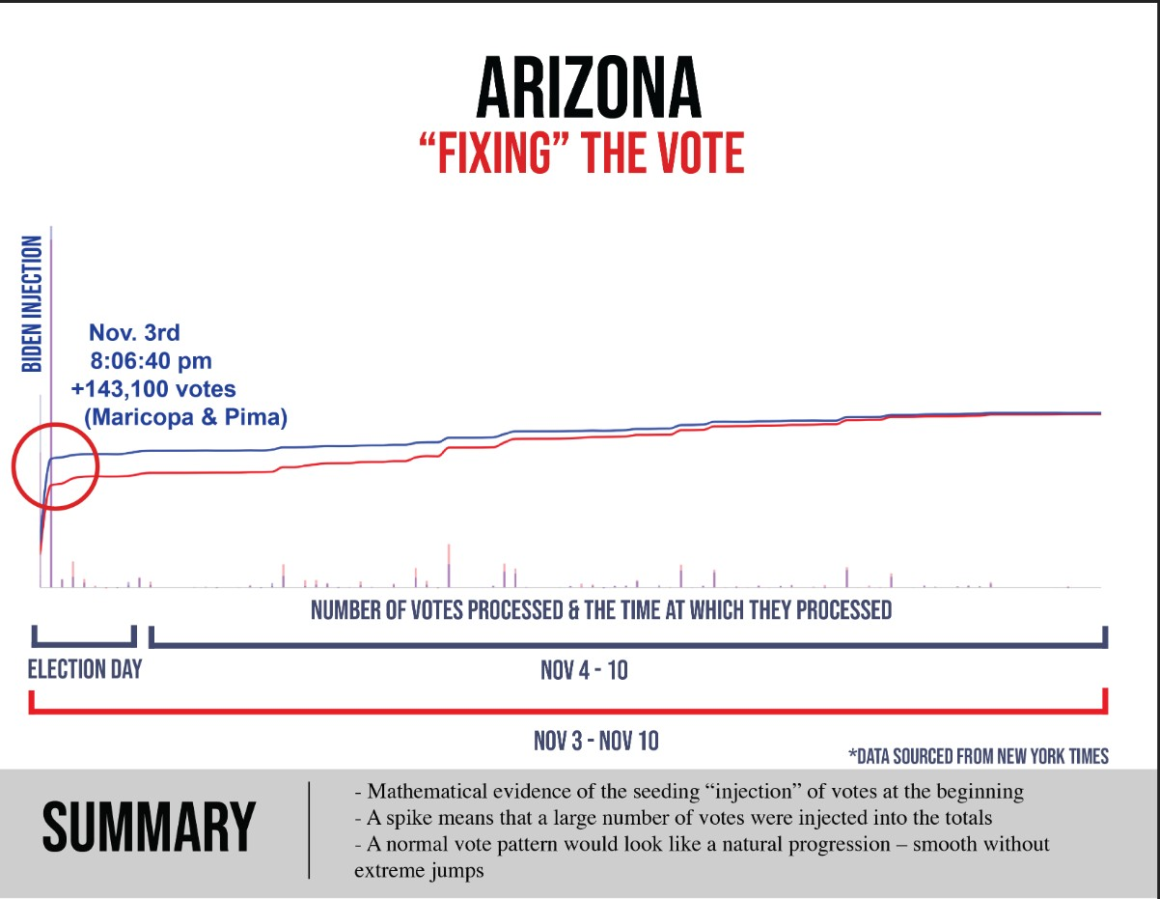
69.

Slide 24
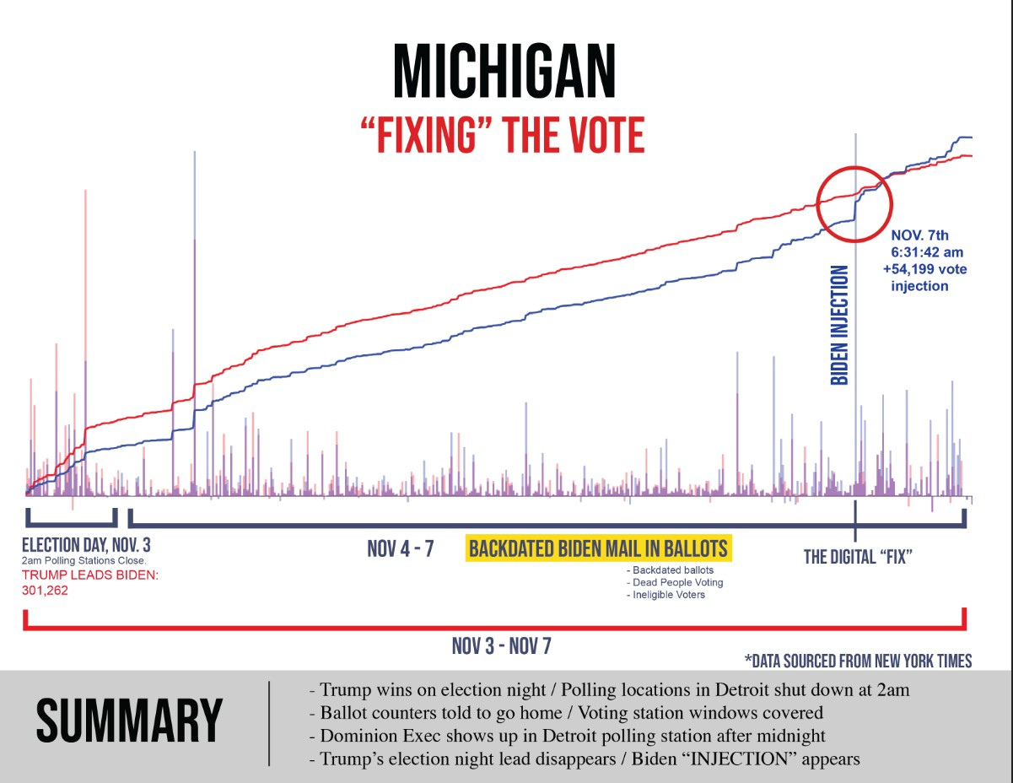
70. Gaussian Elimination without pivoting explains how the algorithm would behave and the election results and data from Michigan confirm FAILURE of algorithm.
71. The “Digital Fix” observed with an increased spike in VOTES for Joe Biden can be determined as evidence of a pivot. Normally it would be assumed that the algorithm had a Complete Pivot.
Wilkinson’s demonstrated the guarantee as :
72.
Such a conjecture allows the growth factor the ability to be upper bound by values closer to n.
Therefore, complete pivoting can’t be observed because there would be too many floating points. Nor can partial as the partial pivoting would overwhelm after the “injection” of votes. Therefore, external factors were used which is evident from the “DIGITAL FIX”
Observing the elections, after a review of Michigan’s data a spike of 54,199 votes to Biden. Because it is pushing and pulling and keeping a short distance between the 2 candidates; but then a spike, which is how an algorithm presents; - and this spike means there was a pause and an insert was made, where they insert an algorithm. Block spikes in votes for JOE BIDEN were NOT paper

Slide 25
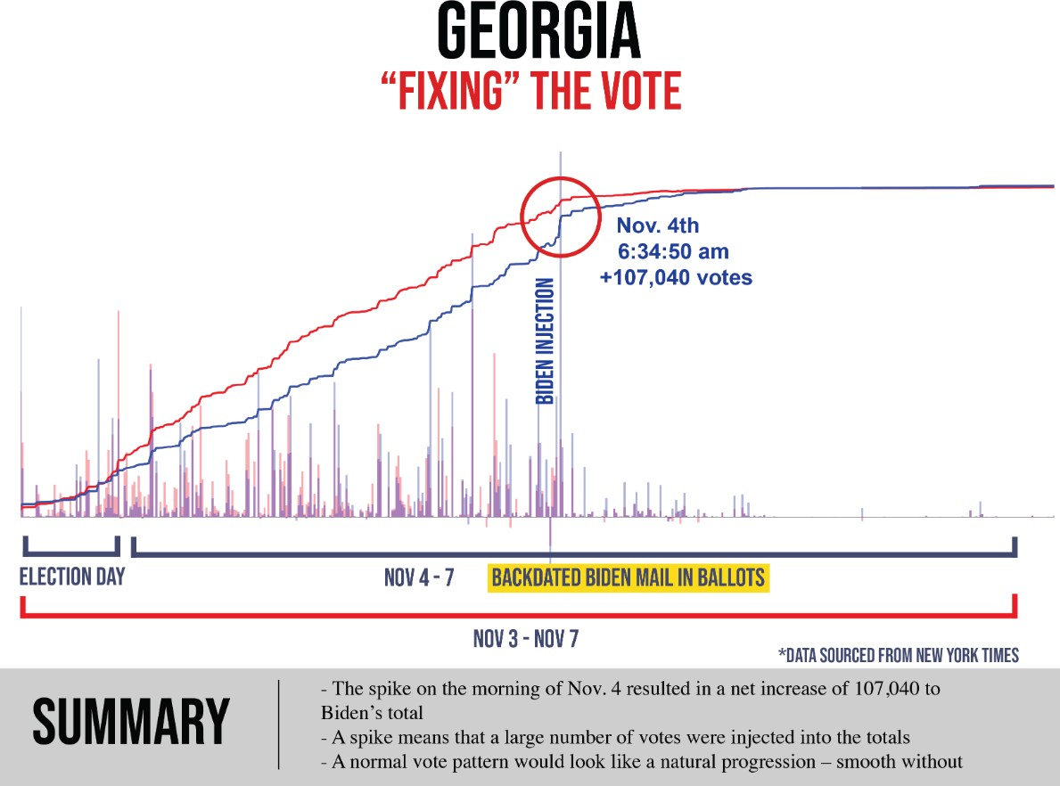
ballots being fed or THUMB DRIVES. The algorithm block adjusted itself and the PEOPLE were creating the evidence to BACK UP the block allocation.
I have witnessed the same behavior of the election software in countries outside of the United States and within the United States. In -------, the elections conducted behaved in the same manner by
allocating BLOCK votes to the candidate “chosen” to win.
Observing the data of the contested states (and others) the algorithm deployed is identical to that which was deployed in 2012 providing Barack Hussein Obama a block allocation to win the 2012 Presidential Elections.
The algorithm looks to have been set to give Joe Biden a 52% win even with an initial 50K+ vote block allocation was provided initially as tallying began (as in case of Arizona too). In the am of
November 4, 2020 the algorithm stopped working, therefore another “block allocation” to remedy the failure of the algorithm. This was done manually as ALL the SYSTEMS shut down NATIONWIDE to avoid detection.
78.
79. In Georgia during the 2016 Presidential Elections a failed attempt to deploy the scripts to block
allocate votes from a centralized location where the “trap-door” key lay an attempt by someone using

Slide 26
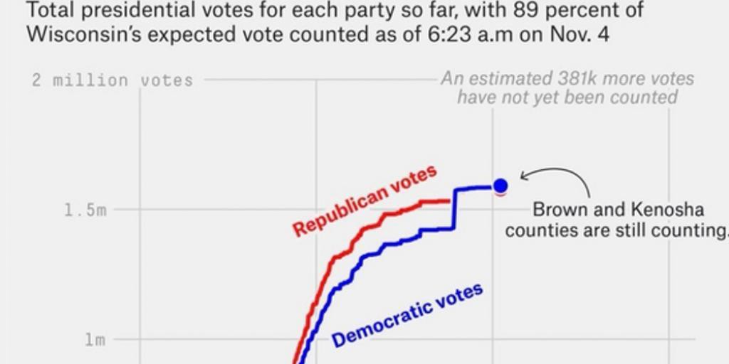
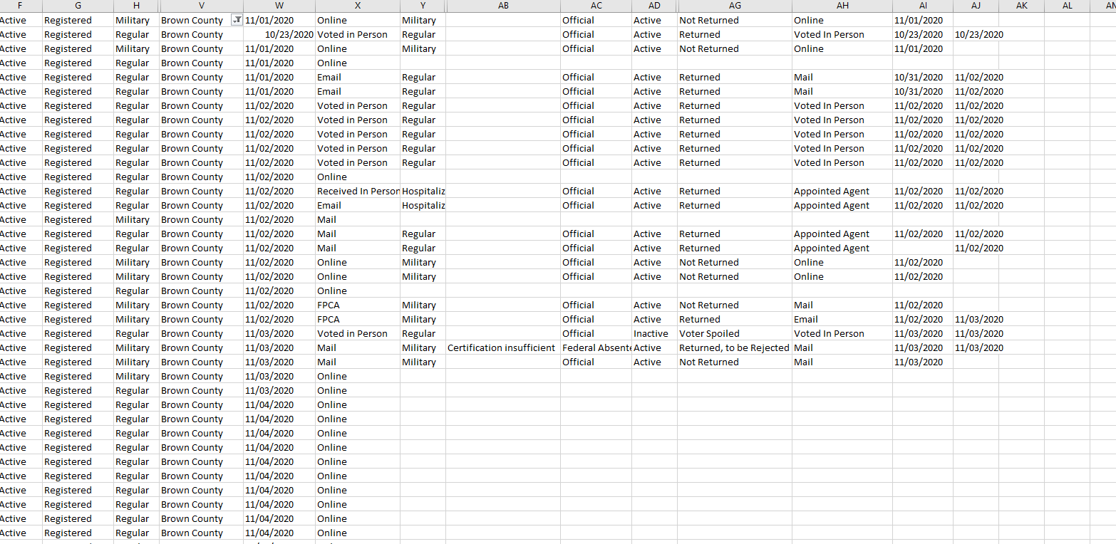
the DHS servers was detected by the state of GA. The GA leadership assumed that it was “Russians” but later they found out that the IP address was that of DHS.
80. In the state of Wisconsin, we observed a considerable BLOCK vote allocation by the algorithm at the SAME TIME it happened across the nation. All systems shut down at around the same time.
81.
82. In Wisconsin there are also irregularities in respect to BALLOT requests. (names AND address Hidden for privacy)
83.

Slide 27
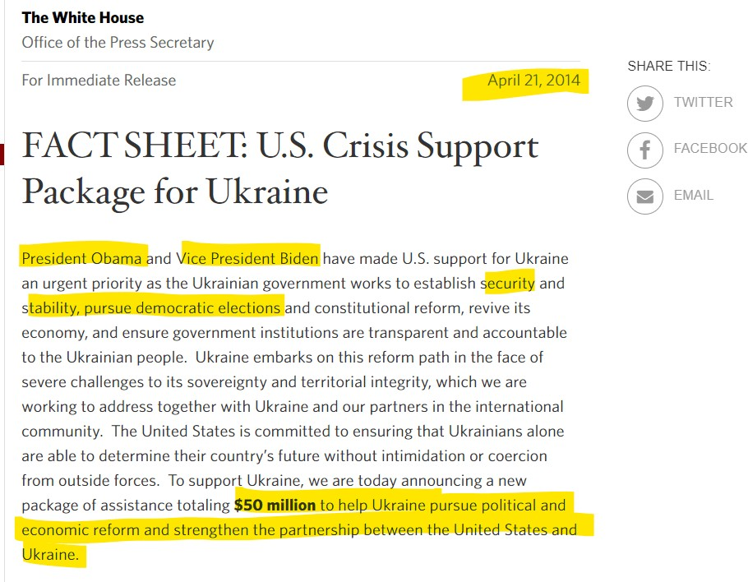
84.
I can personally attest that in 2013 discussions by the Obama / Biden administration were being had
with various agencies in the deployment of such election software to be deployed in ----- in 2013.
On or about April 2013 a one year plan was set to fund and usher elections in -----.
Joe Biden was designated by Barack Hussein Obama to ensure the ----- accepted assistance.
John Owen Brennan and James (Jim) Clapper were responsible for the ushering of the intelligence surrounding the elections in -----.
Under the guise of Crisis support the US Federal Tax Payers funded the deployment of the election software and machines in ------ signing on with Scytl.
90.

Slide 28
Right before the ----- elections it was alleged that CyberBerkut a pro-Russia group infiltrated --- central election computers and deleted key files. These actions supposedly rendered the vote- tallying system inoperable.
In fact, the KEY FILES were the Commitment keys to allow Scytl to tally the votes rather than the election machines. The group had disclosed emails and other documents proving that their election was rigged and that they tried to avoid a fixed election.
The elections were held on May 25, 2014 but in the early AM hours the election results were BLOCKED and the final tally was DELAYED flipping the election in favor of -----.
The claim was that there was a DDoS attack by Russians when in actual fact it was a mitigation of the algorithm to inject block votes as we observed was done for Joe Biden because the KEYS were
unable to be deployed. In the case of -----, the trap-door key was “altered”/deleted/ rendered ineffective. In the case of the US elections, representatives of Dominion/ ES&S/ Smartmatic/ Hart
Intercivic would have to manually deploy them since if the entry points into the systems seemed to have failed.
The vote tallying of all states NATIONWIDE stalled and hung for days – as in the case of Alaska that has about 300K registered voters but was stuck at 56% reporting for almost a week.
This “hanging” indicates a failed deployment of the scripts to block allocate remotely from one location as observed in ------ on May 26, 2014.
This would justify the presence of the election machine software representatives making physical appearances in the states where the election results are currently being contested.
A Dominion Executive appeared at the polling center in Detroit after midnight.
Considering that the hardware of the machines has NOT been examined in Michigan since 2017 by Pro V& V according to Michigan’s own reporting. COTS are an avenue that hackers and bad actors seek to penetrate in order to control operations. Their software updates are the reason vulnerabilities to foreign interference in all operations exist.
The importance of VSTLs in underrated to protect up from foreign interference by way of open access via COTS software. Pro V& V who’s EAC certification EXPIRED on 24 FEB 2017 was contracted with the state of WISCONSIN.
In the United States each state is tasked to conduct and IV& V (Independent Verification and Validation) to provide assurance of the integrity of the votes.
If the “accredited” non-federal entities have NOT received EAC accreditation this is a failure of the states to uphold their own states standards that are federally regulated.
In addition, if the entities had NIST certificates they are NOT sufficing according the HAVA ACT 2002 as the role of NIST is clear.
Curiously, both companies PRO V&V and SLI GAMING received NIST certifications OUTSIDE the 24 month scope.

Slide 29
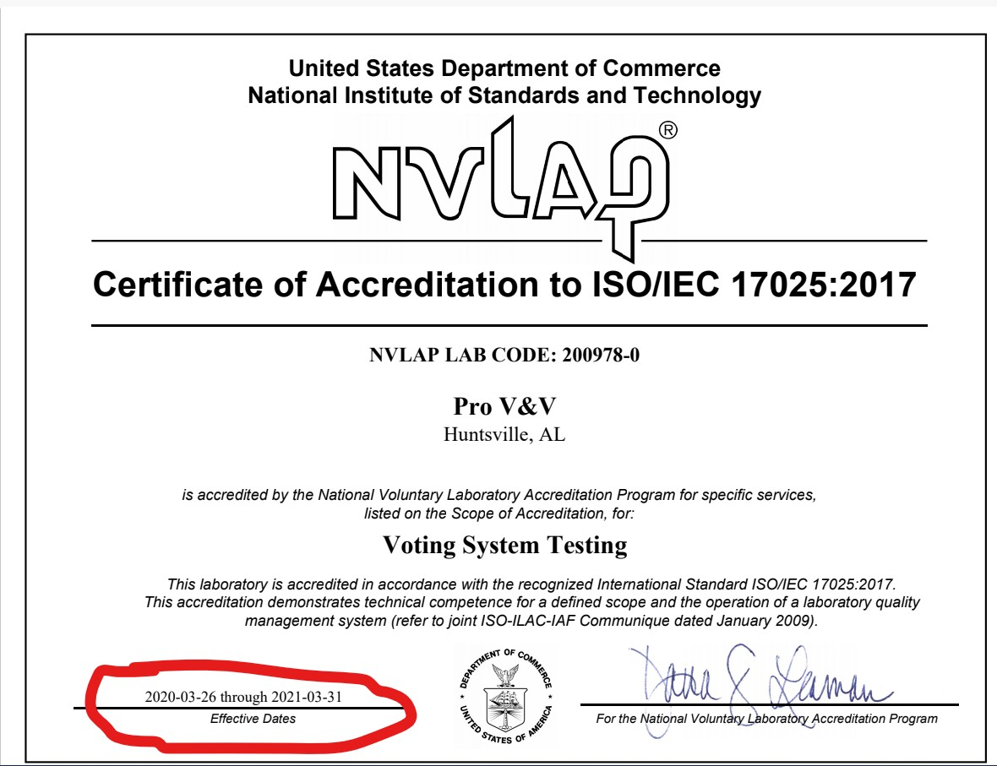
105. PRO V& V received a NIST certification on 26MAR2020 for ONE YEAR. Normally the NIST certification is good for two years to align with that of EAC certification that is good for two years.
106.
The last PRO V& V EAC accreditation certificate (Item 8) of this declaration expired in February 2017 which means that the IV & V conducted by Michigan claiming that they were accredited is false.
The significance of VSTLs being accredited and examining the HARDWARE is key. COTS software updates are the avenues of entry.
As per DOMINION’S own petition, the modems they use are COTS therefore failure to have an accredited VSTL examine the hardware for points of entry by their software is key.

Slide 30
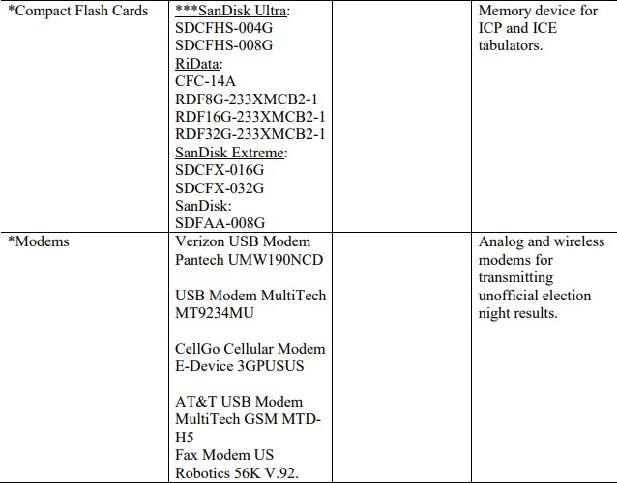
110.
For example and update of Verizon USB Modem Pantech undergoes multiple software updates a
year for it’s hardware. That is most likely the point of entry into the systems.
During the 2014 elections in ---- it was the modems that gave access to the systems where the commitment keys were deleted.
SLI Gaming is the other VSTL “accredited” by the EAC BUT there is no record of their accreditation. In fact, SLI was NIST ISO Certified 27 days before the election which means that PA IV&V was conducted without NIST cert for SLI being valid.

Slide 31
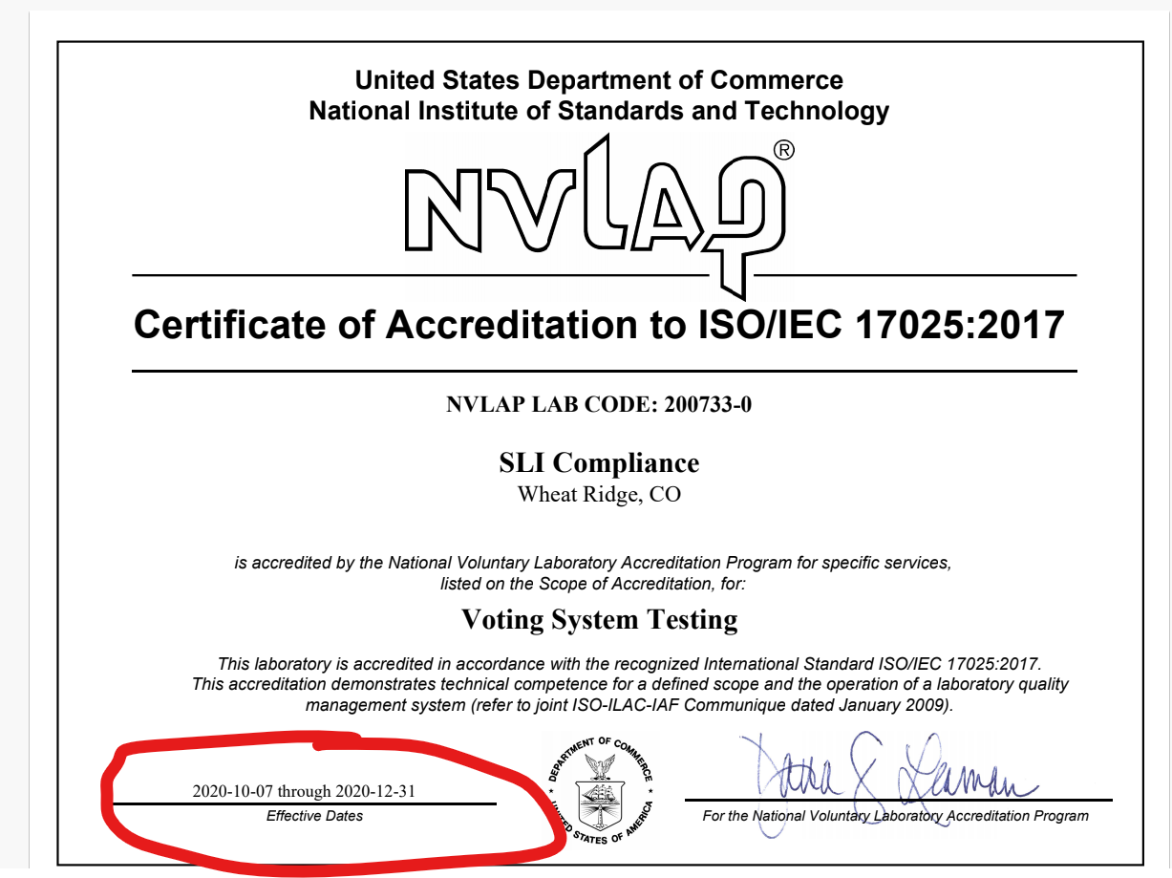
114.
In fact SLI was NIST ISO Certified for less than 90 days.
I can personally attest that high-level officials of the Obama/Biden administration and large private contracting firms met with a software company called GEMS which is ultimately the software ALL election machines run now running under the flag of DOMINION.
GEMS was manifested from SOE software purchased by SCYTL developers and US Federally Funded persons to develop it.
The only way GEMS can be deployed across ALL machines is IF all counties across the nation are housed under the same server networks.
GEMS was tasked in 2009 to a contractor in Tampa, Fl.
GEMS was also fine-tuned in Latvia, Belarus, Serbia and Spain to be localized for EU deployment as observed during the Swissport election debacle.
John McCain’s campaign assisted in FUNDING the development of GEMS web monitoring via WEB Services with 3EDC and Dynology.

Slide 32
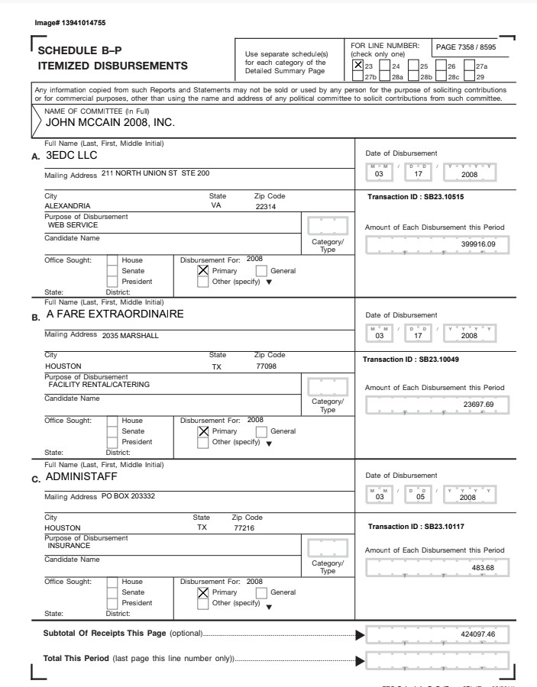
122.
123.
124. AKAMAI Technologies services SCYTL.

Slide 33
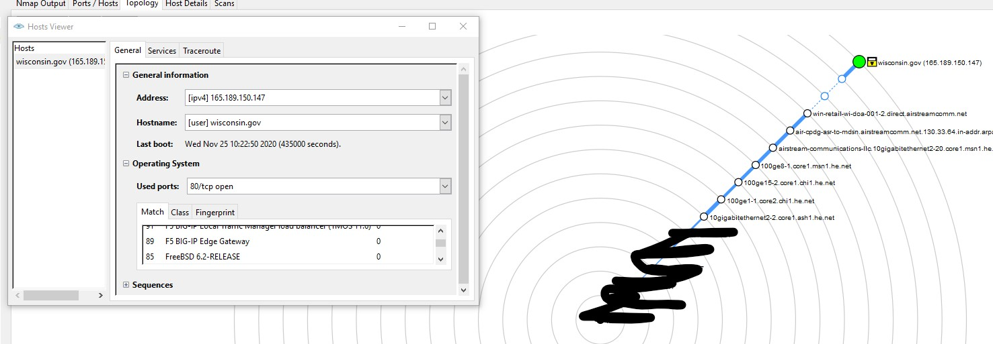
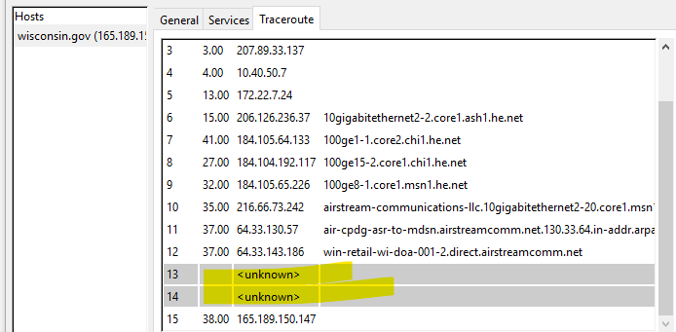
AKAMAI Technologies Houses ALL foreign government sites. (Please see White Paper by Akamai.)
AKAMAI Technologies houses ALL .gov state sites. (ref Item 123 Wisconsin.gov Example)
127.
Wisconsin has EDGE GATEWAY port which is AKAMAI TECHNOLOGIES based out of
GERMANY.
Using AKAMAI Technologies is allowing .gov sites to obfuscate and mask their systems by way of HURRICANE ELECTRIC (he.net) Kicking it to anonymous (AKAMAI Technologies) offshore servers.
130.
AKAMAI Technologies has locations around the world.
AKAMAI Technologies has locations in China (ref item 22)
AKAMAI Technologies has locations in Iran as of 2019.
AKAMAI Technologies merged with UNICOM (CHINESE TELECOMM) in 2018.
AKAMAI Technologies house all state .gov information in GERMANY via TELIA AB.

Slide 34
In my professional opinion, this affidavit presents unambiguous evidence:
That there was Foreign interference, complicit behavior by the previous administrations from 1999 up until today to hinder the voice of the people and US persons knowingly and willingly colluding with foreign powers to steer our 2020 elections that can be named in a classified setting.
Foreign interference is present in the 2020 election in various means namely,
Foreign nationals assisted in the creation of GEMS (Dominion Software Foundation)
Akamai Technologies merged with a Chinese company that makes the COTS components of the election machines providing access to our electronic voting machines.
Foreign investments and interests in the creation of the GEMS software.
US persons holding an office and private individuals knowingly and willingly oversaw fail safes to secure our elections.
The EAC failed to abide by standards set in HAVA ACT 2002.
The IG of the EAC failed to address complaints since their appointment regarding vote integrity
Christy McCormick of the EAC failed to ensure that EAC conducted their duties as set forth by HAVA ACT 2002
Both Patricia Layfield (IG of EAC) and Christy McCormick (Chairwoman of EAC) were appointed by Barack Hussein Obama and have maintained their positions since then.
The EAC failed to have a quorum for over a calendar year leading to the inability to meet the standards of the EAC.
AKAMAI Technologies and Hurricane Electric raise serious concerns for NATSEC due to their ties with foreign hostile nations.
For all the reasons above a complete failure of duty to provide safe and just elections are observed.
For the people of the United States to have confidence in their elections our cybersecurity standards should not be in the hands of foreign nations.
Those responsible within the Intelligence Community directly and indirectly by way of procurement of services should be held accountable for assisting in the development, implementation and promotion of GEMS.
GEMS ------- General Hayden.
In my opinion and from the data and events I have observed --------------------- with the assistance of SHADOWNET under the guise of L3-Communications which is MPRI. This is also confirmed by us.army.mil making the statement that shadownet has been deployed to 30 states which all

Slide 35
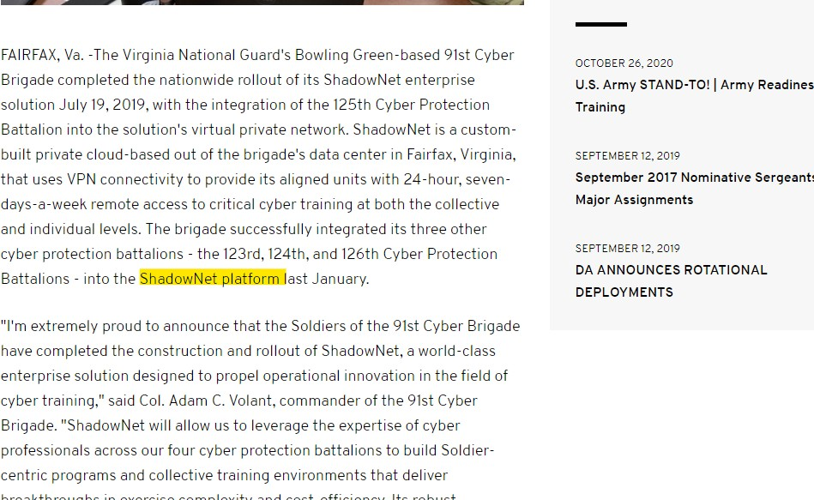
happen to be using Dominion Machines.
154. Based on my research of voter data – it appears that there are approximately 23,000 residents of a Department of Corrections Prison with requests for absentee ballot in Wisconsin. We are currently reviewing and verifying the data and will supplement.

Slide 36
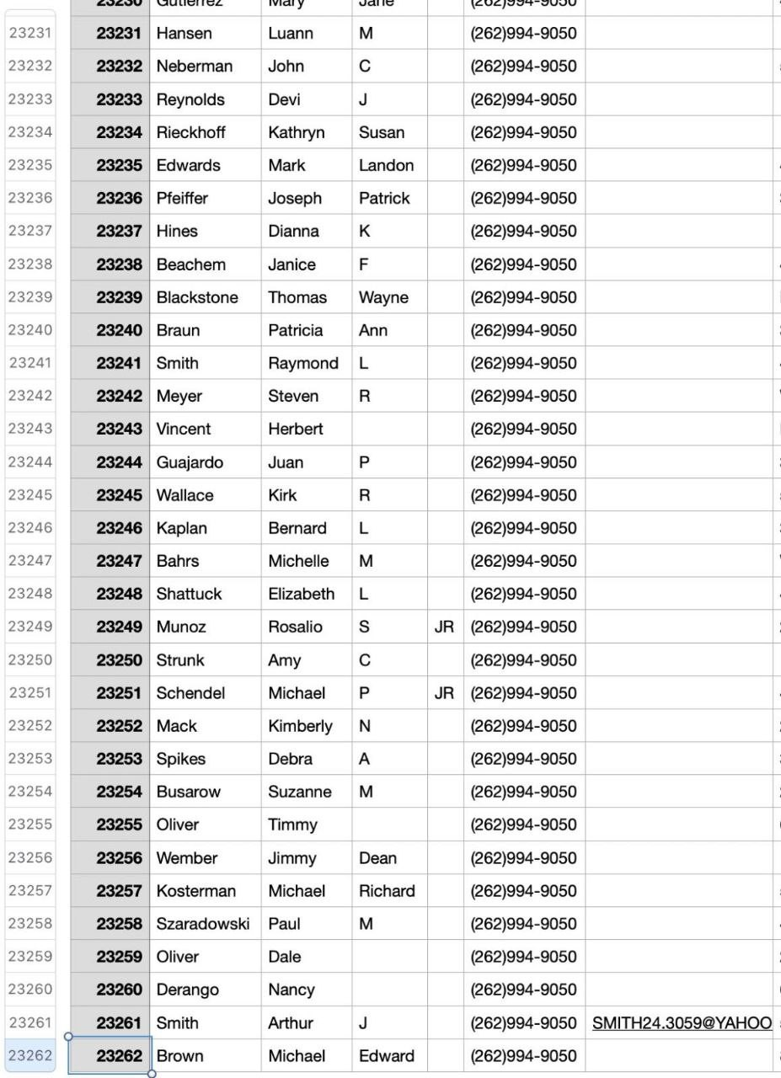
155.

Slide 37
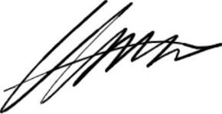
I declare under penalty of perjury that the forgoing is true and correct to the best of my knowledge. Executed this November 29th, 2020.
Terpsehore P Maras

