Slide 1
Are Elections “Secure and Accurate”
in Ohio?
A Review of Ohio Elections 1993 – 2023 with law references
This document available at ohio4truth.com

Slide 2
TABLE OF CONTENTS
Presidential Election Day Act of 1845 . . . . . . . . . . . . . . . . . . . . . 4
National Voter Registration Act (NVRA) 1993 . . . . . . . . . . . . . . . 7 Help America Vote Act (HAVA) . . . . . . . . . . . . . . . . . . . . . . . . . . 13
Help America Vote Verification (HAVV) . . . . . . . . . . . . . . . . . . . 20
Harmonization of Statewide/County Voter Registration Lists . . . 24 Ohio Revised Code, Ohio Elections Manual . . . . . . . . . . . . . . . 29 Confirmation Voter Status. . . . . . . . . . . . . . . . . . . . . . . . . . . . . . 33 Deaths, Non-Voters, Duplicates, Address Changes (NCOA) . . 36 2008 Presidential Election in Ohio . . . . . . . . . . . . . . . . . . . . . . 56 Judicial Watch Lawsuit Against Ohio Officials . . . . . . . . . . . . . . 61 Unsolicited Ballot Application Mailings . . . . . . . . . . . . . . . . . . . 64 Citizenship . . . . . . . . . . . . . . . . . . . . . . . . . . . . . . . . . . . . . . . . . 68
Ohio House Bill 458 Signed into Law Jan 2023. . . . . . . . . . . . . 69 Ohio Senate Bill 71 Introduced Feb 2023 . . . . . . . . . . . . . . . . . 77
Voter Lists Are Not Accurate or Current . . . . . . . . . . . . . . . . . . 79 ohio4truth.com. . . . . . . . . . . . . . . . . . . . . . . . . . . . . . . . . . . . . 103

Slide 3
Why Do Elections Matter
The winners of elections at the federal level control trillions of dollars, at the state level billions, and at the local level millions.
Poorly managed and maintained voter registrations increases the risk and enables election fraud.
The authority to govern is granted through elections. Without fair elections the entire foundation of American government is subverted.

Slide 4
Presidential Election Day Act of 1845
The Constitution delegated national elections to the states.
Congress allowed individual states to select their own election dates.
Eventually it became clear this procedure was problematic.
Knowledge of election results in early voting states affected voter turnout.
In a close election, later voting states and last-minute voters had the power to sway the outcome of an entire election.
The large window to conduct elections across the states enabled voter fraud.

Slide 5
Voter registration was not required. It has been reported that:
“Floaters” crossed state boundaries to vote in multiple states. This practice was named “pipelaying” as the floaters claimed they were in town to lay pipes.
“Repeaters” were voters who changed clothes or altered their appearance to vote in multiple precincts.
Does this sound familiar? Is history repeating itself?

Slide 6
In 1845, following several highly contested presidential elections, US Congress enacted a single paragraph as the Presidential Election Day Act requiring presidential elections shall be held ‘on the Tuesday next after the first Monday in the Month of November”.
Whatever happened to “Election Day”?

Slide 7
National Voter Registration Act 1993 (NVRA)
NVRA is a federal law that requires states to provide a citizen the opportunity to apply and register to vote when applying or renewing a driver’s license.
In the name of ‘convenience’, NVRA aka Motor Voter Act made elections across our country less secure. This bill was signed into law by President Clinton.

Slide 8
VOTER REGISTRATION ELIGIBILITY VIA BMV OR MAIL:
State officials are required to ‘assess’ the eligibility of an applicant, including citizenship based on a statement that specifies each eligibility requirement (including citizenship).
What does ‘assess’ mean?
If a driver’s license is used for voter registration identification, it doesn’t prove citizenship since a legal non-citizen can obtain a driver’s license.
There is no verification of citizenship or voting age.
NVRA SEC. 5 (c) (2) The voter registration application portion of an application for a State motor vehicle driver’s license –
may require only the minimum amount of information necessary to –
(ii) enable State election officials to assess the eligibility of the applicant
shall include a statement that –
states each eligibility requirement (including citizenship);
contains an attestation that the applicant meets each such requirement NVRA SEC. 9 (b) (2) “The mail voter registration form
shall include a statement that –
specifies each eligibility requirement (including citizenship);
contains an attestation that the applicant meets each such requirement”

Slide 9
REMOVE INELIGIBLE PERSONS FROM VOTER ROLLS:
State officials are instructed to make a ‘reasonable’ effort to remove names of ineligible voters in the case of death or change of address.
What is the definition of ‘reasonable effort’?
NVRA SEC. 8 (a) (4) each State shall - conduct a general program that makes a reasonable effort to remove the names of ineligible voters from the official lists of eligible voters by reason of –
the death of the registrant; or
change in the residence of the registrant

Slide 10
RESTRICTIONS IN REMOVING NON-VOTING REGISTRANTS:
NVRA prohibits removing registrants from the voter rolls simply for not voting.
What is the purpose of a voter registration database if it is full of non-voters?
A registrant is mailed a Notice if change-of-address information is received from USPS. If the registrant fails to respond to the Notice and does not vote or have other voter activity for two general elections for Federal office (4 years), their voter registration record is then removed.
NVRA SEC. 8 (b) Any State program or activity to protect the integrity of the electoral process by ensuring the maintenance of an accurate and current voter registration roll for elections for Federal office –
(2) shall not result in the removal of the name of any person from the official list of voters registered to vote in an election for Federal office by reason of the person’s failure to vote.
10 | P a g e

Slide 11
OFFICES REQUIRED TO PROVIDE VOTER REGISTRATION:
In addition to BMV, NVRA requires many state agencies to offer voter-registration services, including but not limited to:
Supplemental Nutrition Program
Medicaid
Children’s Health Insurance Program
Public libraries
Public schools
State colleges and universities
Fishing and hunting license offices
Unemployment Compensation offices
Armed Forces recruitment offices
Agencies are also required to assist persons in completing voter- registration applications.
What could possibly go wrong with so many Agencies offering voter-registration services?
Is it possible assistance applicants are coerced into applying to register to vote in order to obtain assistance?

Slide 12
NVRA SUMMARY:
In the year 1993, the National Voter Rights Act begins voter registration through the BMV, in addition to registration by mail. NVRA uses the ‘honor’ system instead of a ‘verification’ system on information provided to register to vote. It became easier for citizens and potentially non-citizens to register to vote while making it more difficult to remove ineligible voters from the voter rolls.

Slide 13
Help America Vote Act 2002 (HAVA)
HAVA is a federal law in which millions of taxpayer dollars were paid to participating states, including Ohio, to follow election technology and administration requirements, which included the replacement of punch card voting systems. This bill was signed into law by President George W Bush.
HAVA lays the groundwork for introducing ‘election machines’ in our country, and “remote access voting, including voting through the Internet”.
The Election Assistance Commission (EAC) was created which provides certification of voting system hardware and software by accredited laboratories.
HAVA reiterates much of the same information presented in NVRA regarding voter registration and provides more detail for implementing policies.

Slide 14
REMOVE INELIGIBLE REGISTRANTS:
HAVA specifies the state agency to search for ineligible registrants who have died or have a felony status, and requires the removal of duplicate names. HAVA emphasizes the removal of ineligible voters shall be in accordance with State Law.
HAVA SEC 303 (a)(2)
(ii) for purposes of removing names of ineligible voters from the official list of eligible voters –
…the State shall coordinate the computerized list with State agency records on felony status; and
By reason of the death of the registrant . . ., the State shall coordinate the computerized list with State agency records on death.
State shall remove the names of ineligible voters from the computerized list in
accordance with State law.
(iii) duplicate names are eliminated from the computerized list.

Slide 15
MULTI-YEAR PROCESS TO REMOVE INELIGIBLE REGISTRANTS:
Outside of felony status, death or duplicates, the removal of ineligible registrants shall follow the multiple year process to remove ineligible registrants as defined in NVRA. A registrant that is flagged as ineligible is mailed a Notice, and if they do not respond or have other voting activity in the next 2 federal elections (4 years), they are to be removed from the voter registration data base.
HAVA SEC 303 (a)(4) The State election system shall include provisions to ensure that voter registration records in the State are accurate and are updated regularly, including the following:
A System of file maintenance that makes a reasonable effort to remove registrants who are
ineligible to vote from the official of eligible voters. Under such system, consistent with NVRA, registrants who have not responded to a notice and who have not voted in 2 consecutive general elections for Federal office shall be removed from the official list of eligible voters, except that no registrant may be removed solely by reason of a failure to vote.
Safeguards to ensure that eligible voters are not removed in error from the official list of eligible voters.

Slide 16
INFORMATION REQUIRED FOR VOTER REGISTRATION:
HAVA requires a driver’s license to register to vote, and if there is no driver’s license, then the last 4 digits of a social security number. Ohio may have violated HAVA law when a driver’s license number OR last 4 digits of social security number were required for voter registration, since HAVA is designed to be minimum law and states can only create stricter laws.
HAVA SEC 303 (a)(5) (A)
(i) An application for voter registration for an election for Federal office may not be accepted or processed by a State unless the application includes -
(I) in the
case of an applicant who has been issued
a current and valid driver’s license,
the applicant’s driver’s license number;
or
(II) in the
case of any other applicant
(other than an applicant to whom clause (ii)
applies).
(ii)
If an applicant for voter registration for an election for Federal office has not been issued a current and valid driver’s license or social security number, the State shall assign the applicant a number which will serve to identify the applicant for voter registration purposes
… the number assigned under this clause shall be the unique identifying number assigned
under the list.
(iii) The State shall determine whether the information provided by an individual is sufficient to meet the requirements of this subparagraph, in accordance with State law.”

Slide 17
CHECK BOXES FOR CITIZENSHIP AND VOTING AGE:
When applying to register to vote, applicants are asked to check boxes indicating they are a citizen and will be of voting age to register. If they do not check the boxes, HAVA still allows the individual to be registered to vote, but the individual will be required to provide additional identification when voting for the first time.
HAVA SEC 303 (b)(4)(A) Mail voter registration form shall include the following:
The question “Are you a citizen of the USA?” and boxes for the applicant to check to indicate whether the applicant is or is not a citizen of the US.
The question “Will you be 18 years of age on or before election day?” and boxes for the applicant to check to indicate whether or not the applicant will be 18 years of age or
older on election day.
The statement “If you checked ‘no’ in response to either of these questions, do not complete this form.”.
A statement informing the individual that if the form is submitted by mail and the
individual is registering for the first time, the appropriate information required under this section must be submitted with the mail-in registration form in order to avoid the additional identification requirements upon voting for the first time.
HAVA SEC 303 (b)(4)(A)(iv)

Slide 18
DOCUMENTS REQUIRED WHEN VOTING IN-PERSON:
If a registrant votes in-person, a photo id or utility bill, bank statement, government check, paycheck or other government document that shows the name and address of the voter is required.
How does a utility bill, bank statement, government check, paycheck or other government document that shows the name and address of the voter prove the person is the real person named on the document without a photo id?
Is it easy to alter a utility bill, bank statement, government check, paycheck or other government document that shows the name and address of the voter?

Slide 19
DOCUMENTS REQUIRED WHEN VOTING ABSENTEE BY MAIL:
If a registrant votes absentee by mail or drop box, a copy of photo id or utility bill, bank statement, government check, paycheck or other government document that shows the name and address of the voter is required.
Is it easy to alter a copy of a photo id?
How is the person voting with a copy of a photo verified to be the real person indicated on the ballot?
How does a utility bill, bank statement, government check, paycheck or other government document that shows the name and address of the voter prove the person is the real person named on the document without a photo id?
Is it easy to alter a utility bill, bank statement, government check, paycheck or other government document that shows the name and address of the voter?

Slide 20
Help America Vote Verification (HAVV)
The Social Security Administration provides online verification reporting of the last 4 digits of social security number on a voter registration application through HAVV.
Ohio HAVV Results January 2011 to Present:
30% of all last 4 digits of social security number verifications in Ohio were non-matches.
ALMOST ONE OF THREE VOTER REGISTRATION APPLICATIONS IN WHICH THE LAST 4 DIGITS OF SOCIAL SECURITY NUMBER WAS ENTERED AND VERIFIED IN OHIO WAS RETURNED AS A NO MATCH.
20 | P a g e

Slide 21
HAVV:
Average non-matches for all participating states between 2011 to present is 32% .
California had 76% non-matches. Nevada had 67% non-matches.
Georgia had 50% non-matches.
Arizona, Maryland, New York, Oklahoma, South Carolina all had over 40% non-matches.
It appears states are not using this tool uniformly, as during the
years 2011 to present
Kentucky had 3,000 transactions, 800,000, Indiana 2,696,000 and
Michigan 85,000, Ohio
Missouri 2,366,000.

Slide 22
HAVA SUMMARY:
With the passage of HAVA in the year 2002, federal law in the US
continues to use the ‘honor’ system instead of verification of citizenship when
registering to vote.
No federal law has been enacted in the US in over 20 years to correct this flaw in US election systems.
How many illegal aliens have crossed into our US borders since 2002?

Slide 23
OFFICIAL CENTRALIZED VOTER REGISTRATION LIST
Ohio is considered to have a ‘bottom up’ election system in which all 88 counties have their own voter registration databases, and with the passage of HAVA, the Secretary of State holds the official, centralized voter registration list that includes the voter registrations of all counties.
To successfully operate in a ‘bottom up’ election system, the county board of elections need to be the only source updating their county voter registration database. Only then can the county be responsible and accountable for all county data.
Otherwise, the statewide voter registration database and county voter registration databases will likely have integrity issues, as is currently the situation in Ohio.

Slide 24
Harmonization of Statewide and County Voter Registration Databases
Ohio Revised Code specifies a computer program that ‘harmonizes” the voter registration records contained in the statewide database with voter registration records maintained by each county board of elections automatically and daily.
Would one be correct to think if the statewide and county board of elections voter registration databases are harmonized daily, they would match on a daily basis?
ORC 3503.15(C)(2), requires:
A network connection between all county BOE offices and the SOS
A computer program “that harmonizes the records contained in the database with records maintained by each board of elections
ORC 3503.15(D)(2), requires new information to be incorporated into the statewide database “not less than once per day.
County changes are automatically synchronized with the SWVRDB

Slide 25
STATE & CUYAHOGA COUNTY VOTER REGISTRATION DATABASE MISMATCH AS OF 3/6/2023
Daily harmonization of statewide and county voter registration databases do not appear to be working effectively:
1,958 registrations in Cuyahoga voter registration database (VRD) not found in statewide voter registration database (SWVRD)
1,203 registrations in SWVRD not found in Cuyahoga VRD
13,261 registrations have different voter history for 11/3/2020
465 registrations have different voter history for 11/8/2022
4,510 registrations have different registration dates 2,600 registrations have different voter status 1,943 registrations have different street addresses
246 registrations have different last names
45 registrations have different first names
443 registrations have different middle names
44 registrations have different birth dates

Slide 26
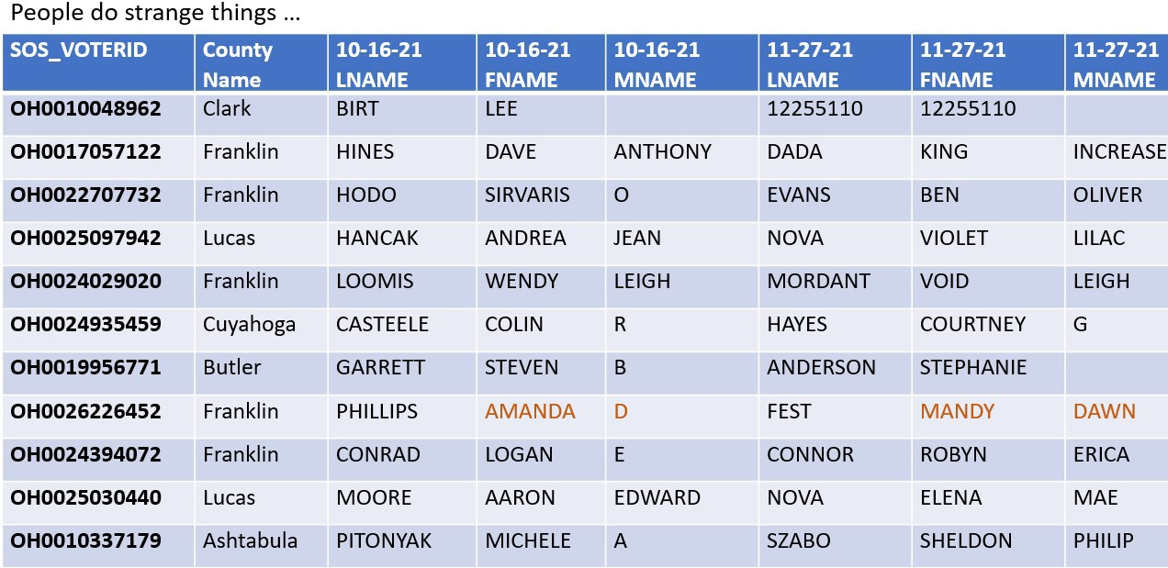
NAME CHANGES OVER TIME IN THE STATEWIDE VOTER REGISTRATION DATABASE

Slide 27
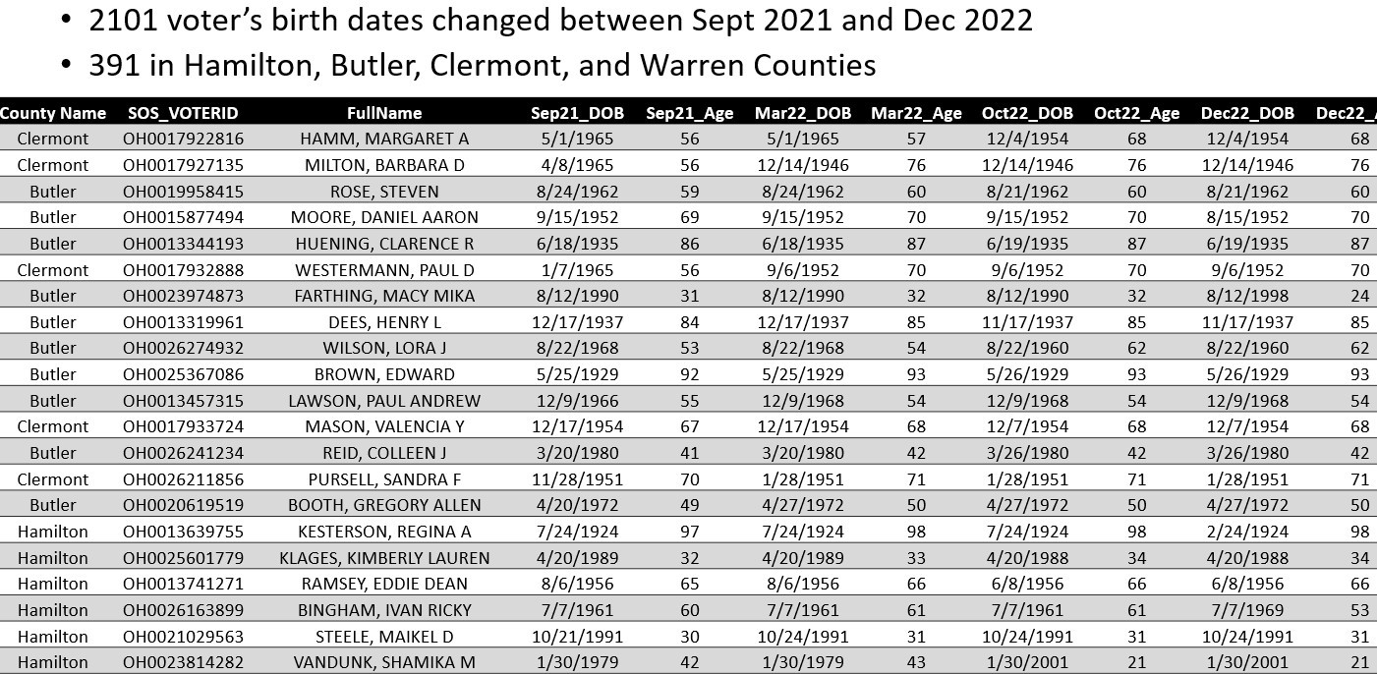
DATE OF BIRTH CHANGES OVER TIME ON THE STATEWIDE VOTER REGISTRATION DATABASE
How does a date of birth change?

Slide 28
WHEN IS AN AUDIT NOT AN AUDIT?
ANSWER: When performing an audit of the voter registration databases.
Ohio law requires the Secretary of State to “establish a process for annually auditing information contained in the statewide voter registration database.”
A directive was published to perform an annual audit which states,
“Attempt to match all information or data in the county voter records in all precincts with the information or data for the same voter records contained in the statewide voter registration database by using the state voter identification numbers. The statewide voter registration system will generate an email notification to the boards of elections indicating any audit discrepancies. The notification will be sent following the completion of the audit.”
There are no provisions for verifying the voter registration records are valid. Invalid county voter registration information passes the audit as long as the statewide voter registration information contains the same invalid information.

Slide 29
Ohio Revised Code and The Ohio Elections Manual
Both NVRA and HAVA establish minimum election administration standards for States and local government who have the responsibility for the administration of Federal elections. States may implement stricter requirements.
NVRA and HAVA reference eligibility requirements, including citizenship when processing new voter registrations, but fall short of requiring verification or providing a method of verification in many cases and reference State Law for implementation.

Slide 30
OHIO REVISED CODE (ORC)
Likewise, the Ohio Revised Code is vague on
verification of voter
registration eligibility.
ORC Section 3503.07 requires citizens of the age of 18 or more that have resided in their current precinct a length of time in order to vote, but lacks clarity in how to verify an individual meets these requirements.
ORC 3503.19 (C ) (1) states “A board of elections that receives a voter
registration application
and is satisfied as to the truth of the statements
made in the registration form
shall register the applicant”.
A BOE will never be held accountable for incorrect processing of voter registrations with this language in Ohio law.
ORC keeps the same multiple year process as NVRA and HAVA to remove an ineligible registrant from the voter registration database.
ORC Section 3503.21
(7) The failure of the registered elector, after having been mailed a confirmation notice, to do either of the following:
Respond to such a notice and vote at least once during a period of four consecutive years, which
period shall include two general federal elections;
Update the elector's registration and vote at least once during a period of four consecutive years, which period shall include two general federal elections.
30 | P a g e

Slide 31
THE OHIO ELECTIONS MANUAL
The Ohio Elections Manual is provided by the Secretary of State and contains over 400 pages of election related information.
Rather than federal and Ohio legislators defining election responsibilities into law, the Secretary of State is often empowered to adopt rules relative to a law.
There is no accountability to the General Assembly regarding rules developed by the Secretary of State. This process enables a future Secretary of State to disregard existing rules and create new rules, which may negate the intent of original laws and lead to unending procedural changes for 88 county boards of elections, which they may or may not follow.
Core processes to ensure data integrity and transparency should be in statutory law while routine details of implementation are best left to the Secretary of State.

Slide 32
VOTER-INITIATED ACTIVITY
Not a law, but defined in the Ohio Elections Manual, voter- initiated activity includes obvious voter related actions such as voting, submitting a valid absentee ballot application, register to vote, and update a voter registration address.
Voter-initiated activity is also defined to include BMV transactions, such as renewing a driver’s license, and signing a petition that is verified by a board of elections.
Renewing a driver’s license or signing a petition can take an otherwise inactive voter registration record where a voter never votes for many years and keep the voter registration record ‘Active’.
What does renewing a driver’s license have to do with voting?

Slide 33
Registered Voters in Confirmation Status
A Notice is sent to the voter when registering to vote, when changing an address or when the board of elections requires additional information. When a voter’s Notice is not returned or returned undeliverable, the voter record is placed in ‘Confirmation’ status.
A Notice is also issued when a voter record doesn’t match BMV/SSA records and the voter record is placed in ‘Confirmation’ Status.
As defined in the Ohio Elections Manual, a voter with a ‘Confirmation’ voter status is a fully qualified elector and is eligible to vote and appears in the pollbook on Election Day. They may be required to provide additional information prior to voting for the first time after receiving a Notice.

Slide 34
ARE ’CONFIRMATION’ STATUS VOTER REGISTRATIONS ARTIFICALLY INFLATING THE NUMBER OF REGISTRANTS ON THE VOTER ROLLS?
Following the Nov 2020 election, 72,000 of Hamilton County’s 600,000 registered voters were in Confirmation Status.
When removing Confirmation Status voter registrations from the voter turnout calculation:
Voter turnout changes from 72% to 82%.
Voter turnout in 120 precincts changes to 90% or higher.
Is it realistic that 9 out of every 10 registered voters in 120 precincts in Hamilton County voted in the 2020 elections?
The voter turnout in 12 Hamilton County precincts increased over 20% when the Confirmation status voters were removed from the calculation.

Slide 35
Following the Nov 2020 election, 9,260 of Wayne County’s 74,470 registered voters were in Confirmation Status.
When removing Confirmation Status voter registrations from the voter turnout calculation:
Voter turnout changes from 74% to 84%.
Voter turnout for one precinct (Wooster College area) increased 18% from 15% to 38%.
Is it possible to vote in Confirmation Status? YES
If voting from Confirmation Status, is Voter Status supposed to change to ‘Active’? YES.
Does this always happen?
Do some voter registrations flip ‘Confirmation’ status to ‘Active’, then vote and flip back to ‘Confirmation’?

Slide 36
Deaths, Non-Voters, Duplicates and Address Changes
Federal laws NVRA and HAVA, along with Ohio Revised Code consistently require States to make a ‘reasonable’ effort in removing the following ineligible voters:
Registered voters who have died
Non-voters who do not respond to a mailed Notice Duplicate registered voters
Registered voters who have moved outside of precinct
YOU decide if ‘reasonable’ efforts were made in removing ineligible voters
after viewing the next set of screens.

Slide 37
DECEASED REGISTERED VOTERS
491 voter registrations have matching death records
13,888 in Nov 2021, 635 in Aug 2022
217 voter registrations with matching death records have ACTIVE Status
9,624 in Nov 2021, 267 in Aug 2022
123 voter registrations with date of death before Oct 4 2020 voted in the Nov 2020 Presidential election.
83 voters with a date of death before Oct 8 2022 voted in the Nov 2022 general election
62 voters were registered after their date of death

Slide 38
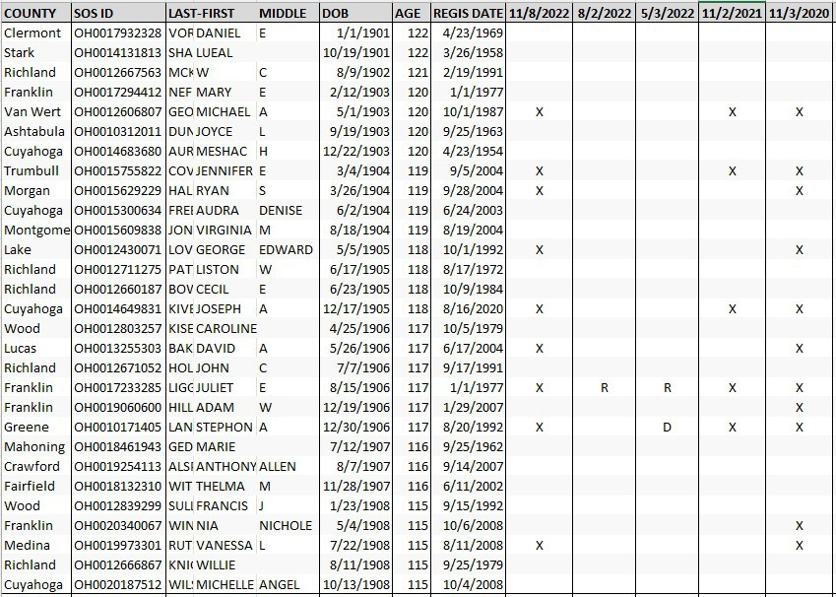
Are Really Old People Registered & Voting in Ohio? YES.
In Nov 2022, over 500 people over the age of 114 were registered in Ohio and 75 voted.

Slide 39
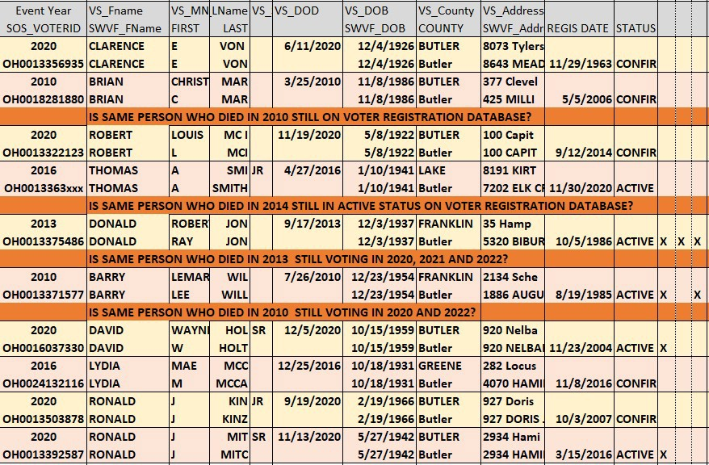
Are dead people from Butler County on the Voter Registration Database? YES. Are they voting? YES.
at minimum, these voter records require an investigation

Slide 40
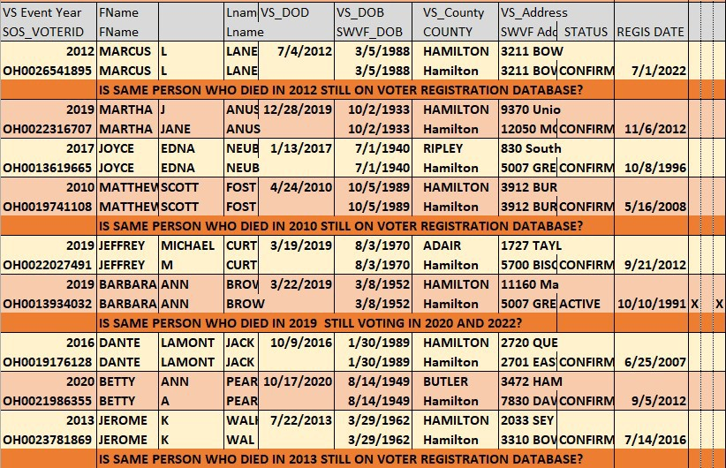
Are dead people from Hamilton County on the Voter Registration Database? YES. Are they voting? YES.
at minimum, these voter records require an investigation
40 | P a g e

Slide 41
How many registrants are on the statewide voter registration database that are age 22 or older
and had an opportunity to vote
in a presidential election before 2020,
yet they have never voted in up to 20 years?
740,953
Almost 10% of all the registrants on the statewide voter registration database age 22 or older have
never, ever voted!

Slide 42
What is the problem if long-term non-voters remain on the voter registration database?
Non-voting registrants -
distorts the true number of electors who are interested in voting.
artificially decreases voter turnout % to avoid going over 100%
allow potential bad actors to insert phantom votes in elections.

Slide 43
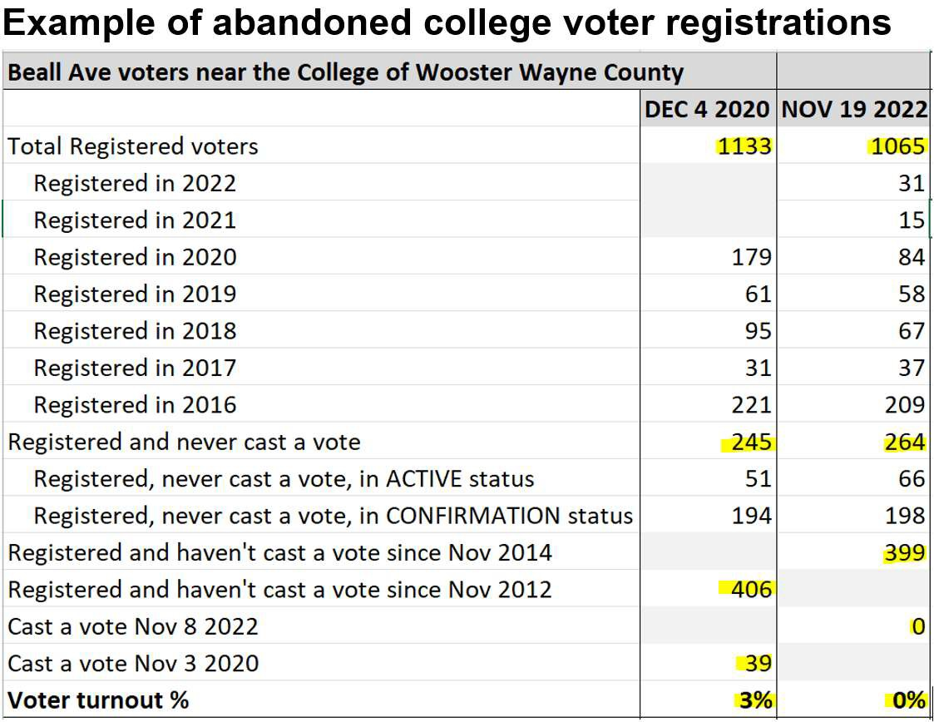

Slide 44
DUPLICATE VOTER REGISTRATIONS
Ohio has specific state laws and SOS directives that address steps for county Boards of Elections to follow to reduce and prevent duplicates.
Per SOS Directive 2022-08: “All county boards of elections must keep their duplicate levels to .03 % on a rolling monthly basis (2,400 voters statewide). The Secretary of State expects all counties to have 0% duplicate voter registrations by the 14th day prior to an election.
What if counties don’t comply to the SOS directives relating to duplicates?
ORC Section 3503.12 | Duplicate registration - All registrations shall be carefully checked, and in case any person is found to have registered more than once, the additional registration forms shall be canceled by the board of elections.
ORC Section 3503.111 | Registering in another county - The board of elections of any county shall register or change the registration of any person determined not to be a resident in that county under
section 3503.02 of the Revised Code, who is a resident and a qualified elector of another county in this
state, on behalf of the county of residence.
The director of any board of elections registering a person under this section shall send the completed registration form of that person to the director of the board of elections of the county of residence, who shall enter the form in the proper registration files and shall promptly send an acknowledgment notice as prescribed by the secretary of state to the registrant at the new address listed on the registration form.
SOS Directive dir2022-08:
All county boards of elections must keep their duplicate levels to .030 percent on
a rolling monthly basis (2,400 voters statewide).
When a board of elections prints Election ay precinct
lists,77 it is vitally important to have local and statewide voter registration lists as accurate s possible.
The
SOS expects all counties to have their duplicate numbers at zero percent by the 14th day prior to an
election.

Slide 45
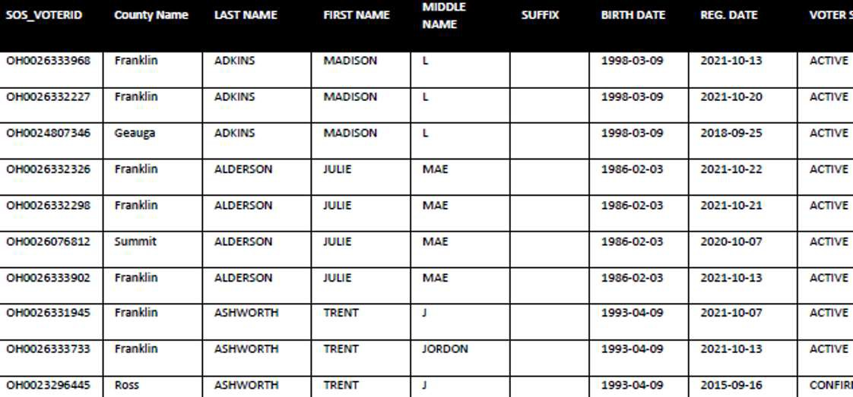
Likely Duplicate Voter Registrations 18,470 likely duplicate voter records on 11/27/21 with
matching First Name, Last Name, Middle Initial and Birth Date; reduced to 4,879 on 12/26/22 after an obvious clean-up.
at minimum, these voter records require an investigation

Slide 46
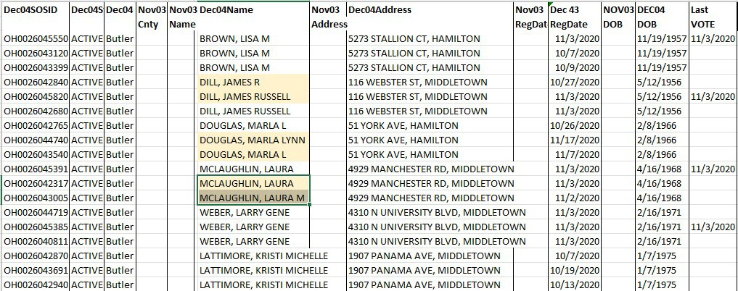
Triplicate Butler County Registrations with Same/ Similar Name, Address & Date of Birth-on Dec 4 2020 SWVRD not Nov 3 2020
The 11/3 registration date may be address changes in which Provisional ballots were counted; are the two other voter records with Registrations Dates after 10/5 deadline valid?
at minimum, these voter records require an investigation

Slide 47
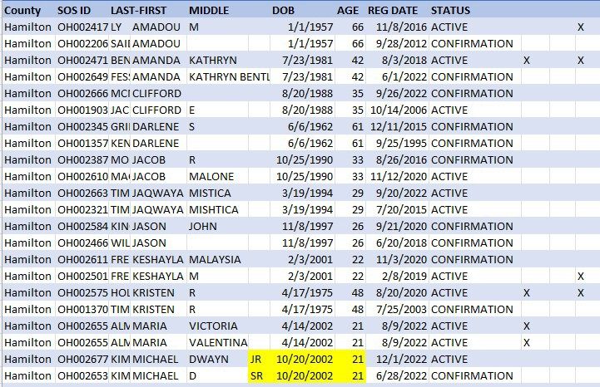
Duplicate Registrations in Hamilton County with Same First Name, Address and Date of Birth
at minimum, these voter records require an investigation

Slide 48
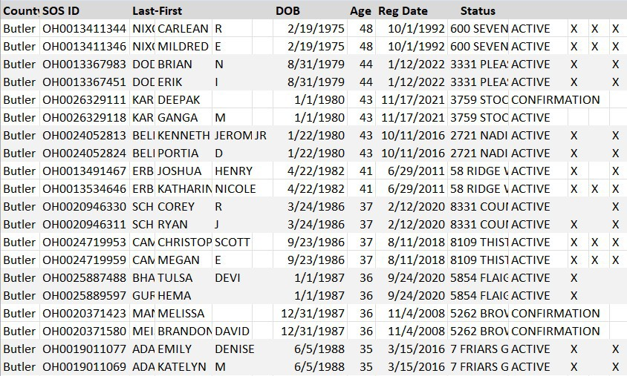
Cloned Registrations in Butler County with Same Date of Birth, Registration Date and Address
at minimum, these voter records require an investigation

Slide 49
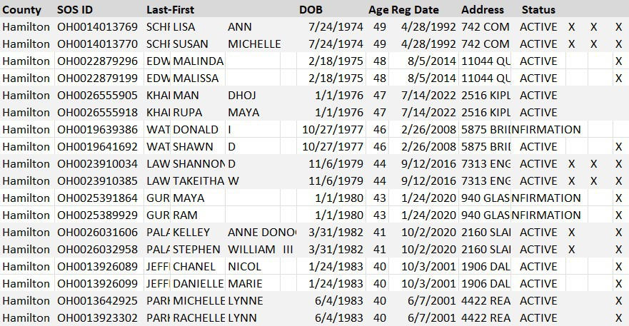
Cloned Registrations in Hamilton County with Same Date of Birth, Registration Date and Address
at minimum, these voter records require an investigation

Slide 50
PROCESSING A VOTER CHANGE OF ADDRESS NATIONAL CHANGE OF ADDRESS (NCOA)
Most voter registration address changes occur through the BMV. When an individual changes their Ohio driver’s license to reflect a new address, they are asked if they want their voter registration updated and if they concur, the address change will also be reflected on the voter registration database.
A registered voter may also update the address on their voter registration in-person at the county Board of Elections, online or by mail.
Anytime there is an address change that is out of an individual’s current precinct, a 2nd voter registration record with the new address is created. The voter registration record with the old address is supposed to be removed, but that doesn’t always happen.
If you are moving, it is recommended you self-cancel your voter registration in the precinct/county you are moving from.
50 | P a g e

Slide 51
If you have
moved within Ohio in the past few years, it is to use the Track Registration feature on
recommended
ohio4truth.com and notify the county BOE if the old address voter registration record has not been canceled.
What about out-of-state moves?
USPS provides a NCOA report of individuals who have filed a permanent change of address form which shows the address in which a person moves FROM and TO.
Under Ohio Revised Code and described in the Ohio Elections Manual, Ohio Secretary of State obtains the NCOA report, and a Confirmation Notice is sent to registrants who have filed the USPS permanent change of address form, which begins the multiple year process (4 years) of removing a person who has moved from the Ohio voter registration database (same as NVRA and HAVA.)
Federal laws created this long and problematic process AND NO A NATIONAL VOTER REGISTRATION DATABASE IS NOT THE ANSWER.

Slide 52
It has been reported over 21 million voters nationwide are registered in more than one state in the US.
At minimum, it causes inflated voter registration lists and manipulates voter turnout. It also creates the potential to vote in two states.
As of Sept 2022, there are a reported 82,260 registered voters in Ohio who may also be registered in another state. For example, there are 13,428 persons who may be registered in both Ohio and Florida.
Ohio citizen volunteers are in the process of analyzing NCOA reports. The following are examples of some recent issues found:
At least 10 Ohio registered voters who may have moved to Washington State are still registered as ACTIVE voters in Ohio (rather than CONFIRMATION Status as Ohio law requires), while also registered in Washington State. As of August 2022, seven (7) of the ten (10) registered in Washington State are actively voting.
7,800 out of a total of 15,023 moves from Michigan to Ohio have been analyzed and of the 7,800, more than 50% (4,092) may be

Slide 53
registered in both Ohio and Michigan. In Ohio, some are still registered in ACTIVE status, some are in CONFIRMATION status.
Keep in mind, votes can still be cast in Ohio if a person is in CONFIRMATION status.
What can We The People do about this problem of being double-registered in 2 states?
We should reach out to our federal and state legislators demanding they create laws to prevent persons from being registered in 2 states at the same time for a long-term period. We the People must be diligent in doing our part to keep our voter registration database clean. It is important to self-cancel your voter registration in the state you move from. Otherwise, you may remain on the voter rolls for over 6 years in that state. Inform and encourage others to do the same.

Slide 54
Between the 741,000 non-voting age 22 and older registrants on the voter rolls that haven’t voted since at least the year 2000, 18,000 likely duplicate voter registrations and tens of thousands of improper registrations in Ohio that may also be registered in another state - - -
It is no coincidence that Ohio’s voter registrations ballooned
18%
from 6,837,000 in 1996 to 8,073,829 in 2020
while the voting age population increased
8%
from 8,358,000 to 9,008,209 during the same time period

Slide 55
A “phantom voter” describes a voter in the voter registration system that is not a real person, or a real person who has been used against their will or knowledge to cast a vote in an election.
Do you believe “phantoms” have infiltrated Ohio’s voter registration systems?

Slide 56
2008 Presidential Election in Ohio
102
Ohio precincts had over 100% turnout
including 2 precincts in Butler County.
There were over more ballots counted in these
60,133
precincts than were registered voters.
Results were signed off by 102 precincts, including 2 in Butler County, followed by 11 counties, including Butler County and certified by Ohio Secretary of State Jennifer Brunner.
Ballot stuffing is obvious in these precincts.
How many other precincts had undetected Ballot Stuffing?
This explains the importance of accurate voter rolls.

Slide 57
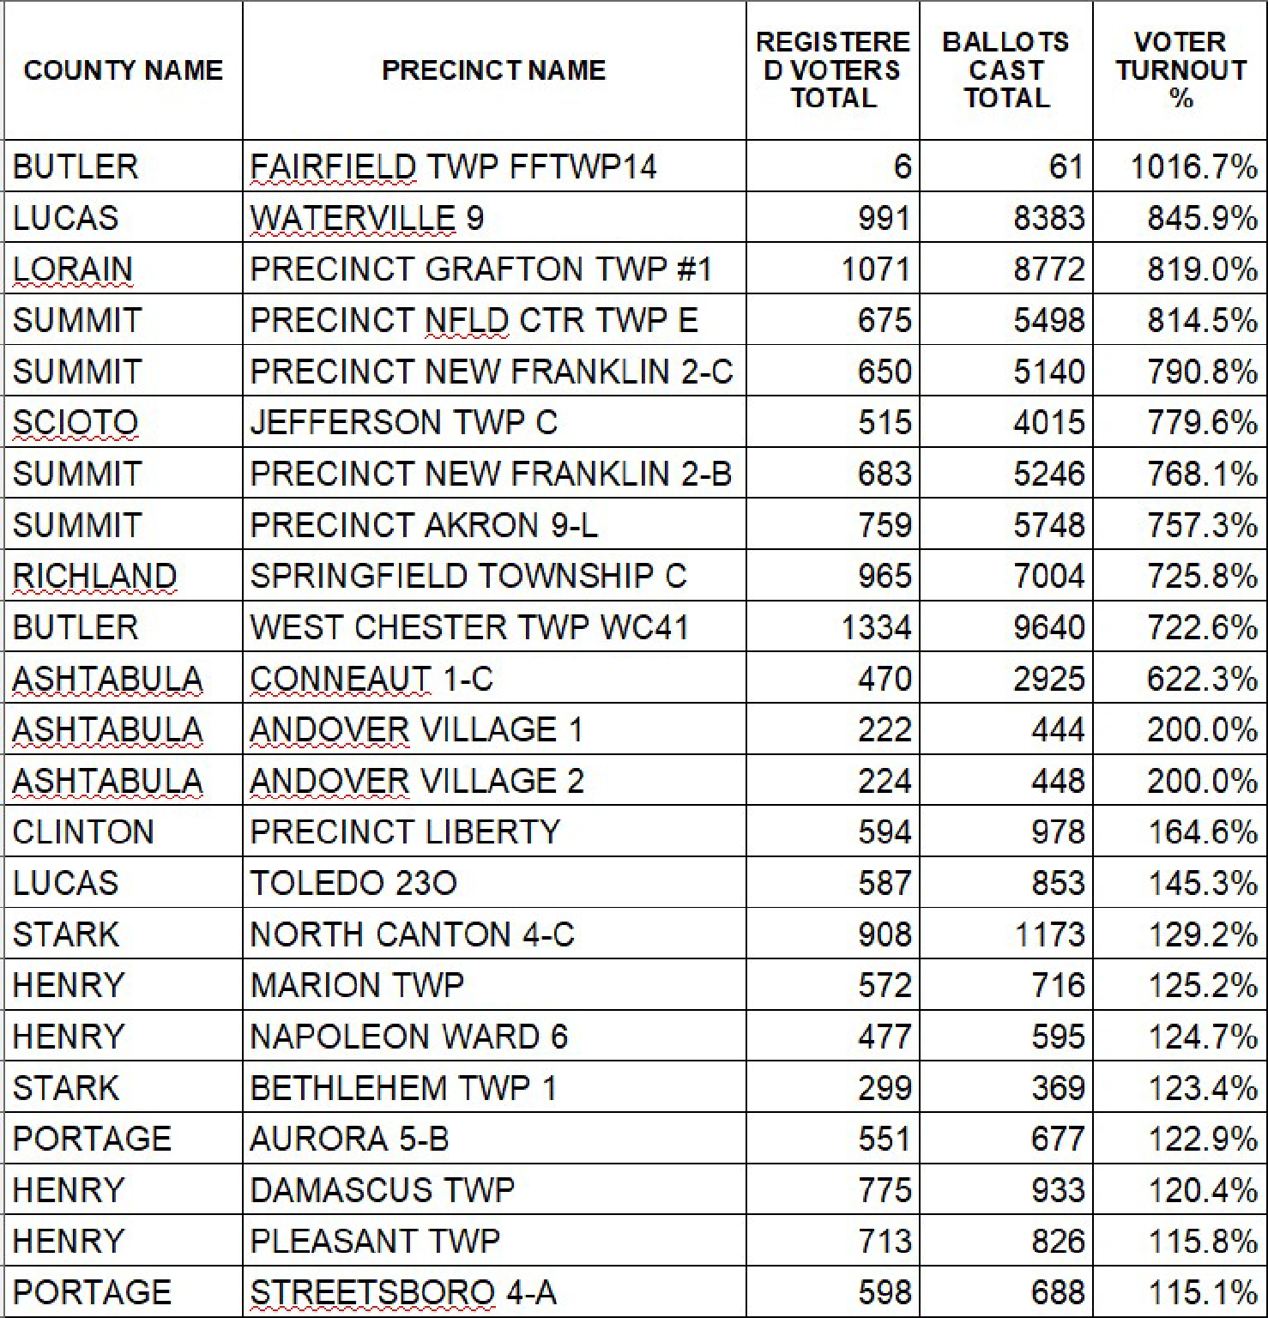

Slide 58
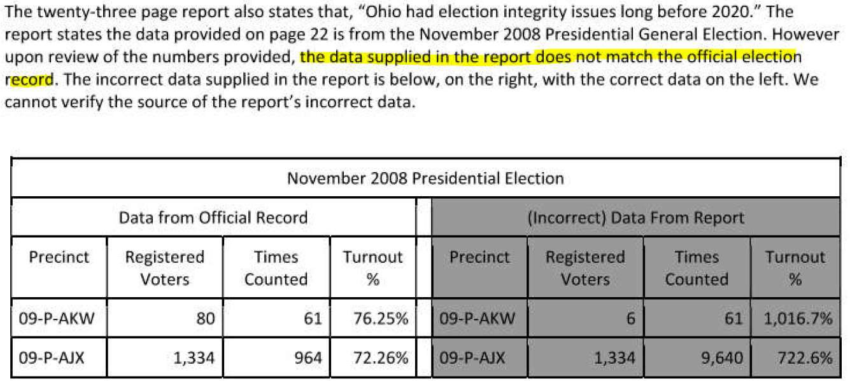
BUTLER COUNTY BOARD OF ELECTIONS RESPONSE TO 2008 PRECINCTS WITH OVER 100% VOTER TURNOUT
Source of “Incorrect” Data: Secretary of State Website

Slide 59
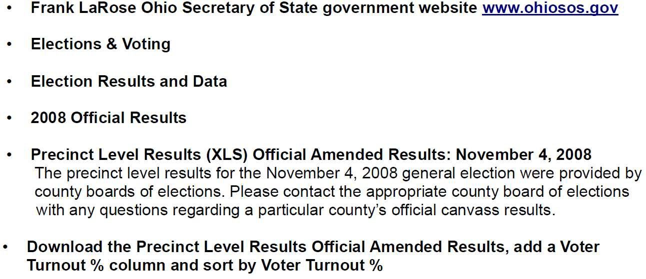
HOW TO ACCESS SECRETARY OF STATE 2008 “OFFICIAL” REPORT SHOWING
OVER 100% VOTER TURNOUT IN 102 PRECINCTS
(as of March 2023)

Slide 60
WHAT HAPPENS WHEN A COUNTY VOTER REGISTRATION DATABASE DOESN’T MATCH THE SECRETARY OF STATE STATEWIDE VOTER REGISTRATION DATABASE?
WHICH LIST IS CORRECT?
???
WHICH LIST IS “OFFICIAL”?
Per the federal law HAVA, the Secretary of State holds the “official, centralized voter registration list.”
WERE THE RESULTS OF ANY ELECTIONS ALTERED BY BALLOT STUFFING IN 2008?
???
60 | P a g e

Slide 61
Judicial Watch & True the Vote File Lawsuit Against Ohio Officials in 2012
Secretary of State Jon Husted and Ohio election officials were alleged to have failed to take reasonable steps to maintain clean voter registration lists as required by NVRA.
The number of persons listed on voter registration rolls in 3 Ohio counties exceeded 100% of the total voting age population. 31 other Ohio counties had registrations between 90% and 100% of total voting age population, where typically only 71% of eligible voters register to vote.

Slide 62
“Election officials in the State of Ohio are shirking their responsibility to maintain
clean voter registration election rolls can lead to
lists. voter
Dirty and
election fraud. Ohio’s voting rolls are a mess and we hope a court will require that they be cleaned up prior to Election Day,” stated Judicial Watch President
~Tom Fitton.

Slide 63
The lawsuit further stated that research conducted by Pew Charitable Trusts published that approximately 24 million active voter registrations throughout the US – one out of every eight registrations – are no longer valid or are significantly inaccurate.
In 2014, Ohio entered into a settlement agreement with Judicial Watch, and in 2018 the Supreme Court upheld the agreement to maintain accurate voting rolls as valid and enforceable.

Slide 64
Unsolicited Ballot Application Mailings
Secretary of State Jon Husted began mailing unsolicited ballot applications to all Ohio electors for presidential and gubernatorial elections in 2012.
It has been reported the cost in 2020 was $1.1 million, paid for with federal taxpayer funded coronavirus relief money.
The estimated cost from Ohio taxpayers to mail unsolicited ballot applications to all electors in 2012, 2014, 2016, 2018 , 2020 and 2022 is around $6 million.
Is this how you want your Ohio tax dollars to be spent?
If you don’t want future Ohio taxpayer money to go towards mailing unsolicited ballot applications to all Ohio electors, contact the Secretary of State and your State legislators.

Slide 65
ELECTRONIC REGISTRATION INFORMATION CENTER (ERIC)
ERIC was formed in 2012 and advertised as a non-profit organization with a mission to assist States improve the accuracy of America’s voter rolls and increase access to voter registration for all eligible citizens.
Ohio joined ERIC in 2016 while Jon Husted was Secretary of State.
As of November 2022, 32 states were members of ERIC.
Since ERIC is not located in Ohio, it may violate HAVA by sharing Ohio’s voter registration records outside of Ohio.
Section 21083 (a)(1)(A)(iv) The computerized list shall be
coordinated with other agency databases within the State.

Slide 66
Ohio driver’s license and state identification number are required to be submitted to ERIC as stated in Exhibit B of the ERIC Bylaws, along with confidential citizen information from Ohio state agencies such as Dept. of Health, Job & Family Services, Medicaid, Rehabilitation & Corrections.
HAVA Section 21083 (a) (4) states, “The State election system shall include provisions to ensure that voter registration records in the State are accurate and are updated regularly, including the following: A system of file maintenance that makes a reasonable effort to remove registrants who are ineligible to vote from the official list of eligible voters.”

Slide 67
ERIC was supposed to provide the resources for Ohio and other states to clean up all the out-of-state NCOA change of addresses and deaths; however, they failed miserably in improving the accuracy of America’s voter rolls.
Secretary of State LaRose terminated ERIC on March 18, 2023, saying “I cannot justify the use of Ohio’s tax dollars for an organization that seems intent on rejecting meaningful accountability, publicly maligning my motives, and waging a relentless campaign of misinformation about this effort,” LaRose wrote. “Additionally, I cannot accept the board’s refusal – for a third time – to adopt basic reforms to the use of ERIC’s data-sharing services.
Louisiana, Alabama, Missouri, Florida, West Virginia, Ohio and Iowa have all recently terminated ERIC in their states. It is reported that Alaska and Texas are considering withdrawing.

Slide 68
Ohio Citizenship Voting Amendment November 2022
Ohioans overwhelmingly voted for State Issue 2 amending the state constitution to prohibit local governments from allowing noncitizens to vote in local elections.
The Citizenship Voting Requirement Amendment passed with 77% of Ohio elector votes.
In 2022, Article V , Section 1 of the Ohio Constitution read, “Every citizen of the United States . . . is entitled to vote at all elections.”
This amendment replaced the section with the following: “Only a citizen of the United States . . . is entitled to vote at all elections.”
68 | P a g e

Slide 69
House Bill 458 Signed into Law Jan 2023
ALLOWS MAILING OF UNSOLICITED BALLOT APPLICATIONS:
The Secretary of State is able to continue mailing unsolicited application for absent voter’s ballots if conditions are met, including
69 | P a g e

Slide 70
the general assembly appropriates funds, and provides related reporting. Sec. 111.31
VOTER REGISTRATION ONLINE:
Under continuing law, to register online, a person must provide both an Ohio driver’s license/state id ***and*** the last 4 digits of the person’s social security number (ssn).
How is the person registering online verified to be the real person indicated on the online application?
Are the driver’s license/state id and last 4 digits of ssn verified?
How is citizenship verified when last 4 digits of ssn is provided? How is address verified if registering with last 4 digits of ssn?
How is citizenship verified on existing DL/ID that don’t indicate a non-citizen, as legal non-citizens may obtain a driver’s license?
VOTER REGISTRATION BY MAIL:
A driver’s license or state id number ***or*** the last 4 digits of social security number is required to register to vote.
70 | P a g e

Slide 71
How is the person filling out the registration application verified to be the real person indicated on the absentee application?
Why aren’t voters registering by mail treated equally as voters registering online and require Ohio DL/ID ***and*** last 4 digits of ssn/at least a copy of photo id?
If providing the last 4 digits of social security number, how can the person be verified to be a citizen, as legal non-citizens can obtain a social security number?
If providing the last 4 digits of social security number, how is the residential address verified?
Does this violate HAVA which requires the last 4 digits of social security number only if an individual doesn’t have a driver’s license or state id?
ID REQUIRED TO VOTE IN-PERSON:
A photo id (driver’s license, state id, US passport or military id) is required to vote in person, unless the elector has a

Slide 72
religious objection to being photographed, in which case the last 4 digits of social security number is required.
How is address verified on identifications without an address on the id, such as a US passport?
How is the current residential address verified when the last 4 digits of ssn is provided?
ID REQUIRED TO VOTE ABSENTEE BY MAIL:
One of the following forms of identification is required:
1. An Ohio driver’s license/state ID (DL/ID) number

Slide 73
2. Last 4 digits of social security number
3. Copy of photo id (DL/ID US passport or military id)
How is person voting absentee verified to be the real person voting?
Why aren’t absentee voters by mail treated equally as vote in- person and require at least a copy of photo ID, which will have the DL/ID number on it, and allow the last 4 digits of social security number only if there is a religious objection?
How is the current residential address verified when last 4 digits of ssn is provided?
Is driver’s license/state ID number or copy of photo id verified?
NON-CITIZEN DESIGNATION ON PHOTO ID:
Beginning in April 2023, driver’s licenses and state ids from the BMV will apply a non-citizen designation if the individual is not a

Slide 74
citizen. Since it will It will take a minimum of 8 years for all current driver’s licenses and state ids to designate non-citizens.
ALLOWS DROP BOXES:
Even though drop boxes have been used in previous elections, they were never specified in law. Now they are.
ABSENT BY MAIL BALLOTS ARRIVAL DATE:
Requires all absent voter’s ballots that are returned by mail to arrive at the board of elections by the fourth day after Election Day, instead of the tenth day after Election Day. While this is an improvement over the 10-day time period, accepting any absent by mail ballots beyond Election Day allows election results to be delayed and potential infiltration of ballots between Election Day and four days after Election Day.
IMPROPER RETURN OF ABSENT BALLOTS:

Slide 75
“Leaves the Revised Code silent” on the issue of whether absentee voter’s ballots can be counted if they are returned to the board inside the return envelope but not inside the identification envelope. If the rules are that the ballot must be inside the return envelope,
and an elector does not follow those rules, the absentee ballot should not count. If time allows, the board of elections can contact the individual to arrange for the voter to resubmit.
CURBSIDE VOTING:
Allows an elector with a disability to vote in the elector’s vehicle or at the door of the polling place with assistance from a bipartisan team.

Slide 76
CHAIN OF CUSTODY:
This new law does not improve chain-of-custody vulnerabilities:
As soon as an absentee ballot application or absentee ballot is mailed to a registrant, chain-of-custody is lost. There is no proof the registrant in which the absentee ballot application or ballot application is intended receives the absentee ballot application or ballot.
As soon as an absentee ballot application or absentee ballot is mailed from a registrant to the county BOE, chain-of-custody is lost. There is no proof the absentee ballot application or absentee ballot is received by the BOE without potential manipulation of the ballot application or ballot.
As soon as an absentee ballot is dropped off at a county BOE, chain-of- custody is lost. There is no proof the person dropping off the absentee ballot is the voter or approved drop-off person. There is no tracking or log of persons retrieving ballots from the drop box.
As soon as a paper ballot is scanned into a tabulator aka electronic voting machine, chain-of-custody is lost. There is no proof the tabulator correctly applies votes as intended on the paper ballot.
As soon as a voter submits their selections on an electronic voting machine, chain-of-custody is lost. There is no proof the electronic voting machine correctly applies votes as intended.
The only way to guarantee chain-of-custody is to hand count paper ballots on election day.

Slide 77
“Voter fraud, including dead people voting,
non-citizens trying to register and double voting;
it’s happened, it’s happened here in Ohio.
Having good data to help clean the voter rolls will help make it tougher to cheat
and result in better elections and improved voter confidence.”
Senator Gavarone 2/22/2023 SB71 press conference

Slide 78
Senate Bill 71 Introduced Feb 2023 Data Analysis Transparency Archive (DATA) Act
POSITIVE ITEMS IN THE BILL:
Creates the Office of Data Analytics and Archives to retain, analyze and publish election data.
Codifies voter registration data fields to be consistent across all counties.
Publishes standardized election data and results online, allowing for full transparency of results, both immediately following an election for auditing purposes and over time for comparative analysis year-over-year.
Standardizes the transfer of election data from each county to the Secretary of State’s office and archives election data.

Slide 79
AREAS IN NEED OF IMPROVEMENT:
Many details in the bill are left up to the Secretary of State to develop rules. This creates problems if the rules developed do not solve the problem intended in the bill, and a future Secretary of State may change, remove or add new rules, potentially nullifying items in a bill.
Citizen volunteers are actively working on very important modifications to this bill:
Identify specific requirements to ensure the integrity of Ohio’s voter registration databases, and allow easily accessible access to public data.
Specify the election records to be archived.
Replace the complex state and county voter id numbers with a standard database practice sequential record id number.
Require citizenship to be verified.
Assure HAVA law is followed and citizen personally identification information is not shared with non-governmental organizations outside of Ohio (ERIC or similar).

Slide 80
Patriot citizen volunteers need your help to pass the much needed improvements to this bill!
It is currently in committee in the Ohio Senate. Please follow volunteer citizen updates that will be posted to ohio4truth.com and reach out to your senator and request they make much needed changes to the bill before passing it.
When the bill arrives in the House, contact your Representative and request the same!
Inform friends and family across Ohio to do the same!
80 | P a g e

Slide 81
Voter Registration Lists Are Not Accurate
NVRA federal law requires States to implement procedures to maintain
accurate and current voter registration lists.
HAVA federal law requires that voter registration records in
the State are accurate.
Do you consider the following as “accurate and current voter registration lists”?

Slide 82
Butler County Voters Registered After OCT 5 2020 Deadline and Voted Nov 3 2020
5,927 New voters registered after Oct 5 2020 deadline to vote in Nov 3 2020 election, yet voted in the Nov 3 2020 election
3,407 Less all Provisional ballots counted.
It is possible Provisional ballots were cast by registrants who moved into Butler County from another precinct or county.
These Provisional ballots create a new voter registration record in Butler County with a new registration date; the voter is new to Butler County, but not a new registered voter. It is very unlikely that all Provisional ballots are due to out of county moves.
2,520 MINIMUM SUSPICIOUS VOTES FOR VOTER REGISTRATIONS AFTER OCT 5 2020 DEADLINE

Slide 83
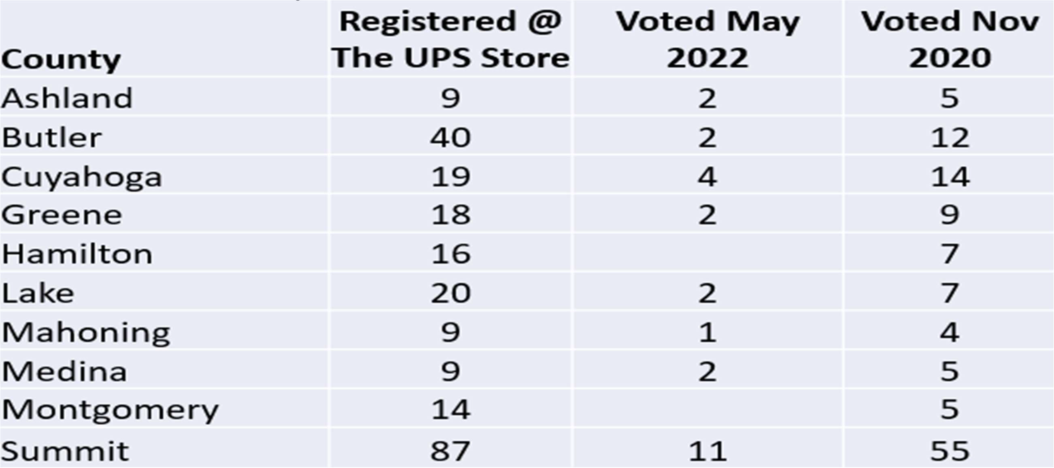
This issue was brought to the attention of Butler County BOE 10/10/2022 with no apparent investigation.
Registered Voters with UPS Store as Residential Address
Registering and voting from a non-residence address is against Ohio law. 30 Ohio counties have voters illegally registered at The UPS Store; many vote.
ORC Section 3503.02 Residence determination rules.

Slide 84
Registered Voters in Butler County with UPS Store as Residential Address in Violation of Ohio Law
All registrars and precinct election officials, in determining the residence of a person offering to register or vote, shall be governed by the following rules: That place shall be considered the residence of a person in which the person’s habitation is fixed and to which, whenever the person is absent, the person has the intention of returning.

Slide 85
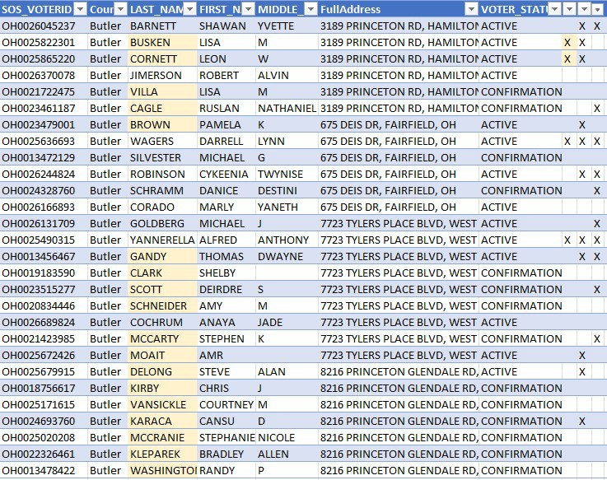
Registered Voters in Butler County with UPS Store as Residential Address is in violation of Ohio Law

Slide 86
Butler County Board of Elections was notified on October 10, 2022 of registered voters using UPS Stores as their residence which is against Ohio law 3503.02.
On January 31, 2023 Butler County Board of Elections responded, advising that the UPS Store addresses were added to the list of prohibited residential addresses in which to register to vote.
Did Butler County BOE take any actions to remove the ineligible voter registration records reported to them on Oct 10 2022?
IT APPEARS NOT.
Did anyone vote from the UPS Stores after this issue was reported to Butler County BOE Oct 10 2022? YES.
41,522 Butler County New Voter Registrations Jan 1 2020
to Oct 5 2020 of which 33,372 Voted Nov 3 2020

Slide 87
41,522 is an unusually high number of new voter registrations for one year in Butler County. Neighboring Hamilton County, whose population is more than twice the size of Butler County had a comparable 43,498 new voter registrations in the same time period.
There were new voter registrations EVERY SINGLE DAY in the nine month period Jan 1 2020 and Oct 5 2020.
There were over 8,000 new voters registered in Butler County between Oct 1 2020 and Oct 5 2020.
1,542 new voter registrations were received on Oct 5 2020, the deadline to register and vote in the Nov 3 2020 election.
Are all of these new voter registrations legitimate?
This issue was brought to the attention of Butler County BOE 10/10/2022 with no apparent investigation.
Butler County had 262% Increase in Voters Age 18-24 Age 18-24 in Nov 2020:

Slide 88
There was an enormous increase in the number of voters in the 18-24 age group in 2020, increasing from 6,507 voting registrants in 2016 to 17,040 in 2020, a gain of 10,533 or 262%.
There were increases in all age groups 25 – 74; however, the increase per age group was no more than 3,600 for every age group EXCEPT the 18-24 age group.
This is an unnatural increase in votes.
Are all of these new voter registrations legitimate?
This issue was brought to the attention of Butler County BOE 10/10/2022 with no apparent investigation.
Hamilton County: 810 Registered to Vote on a Federal Holiday before Online Registration was Available

Slide 89
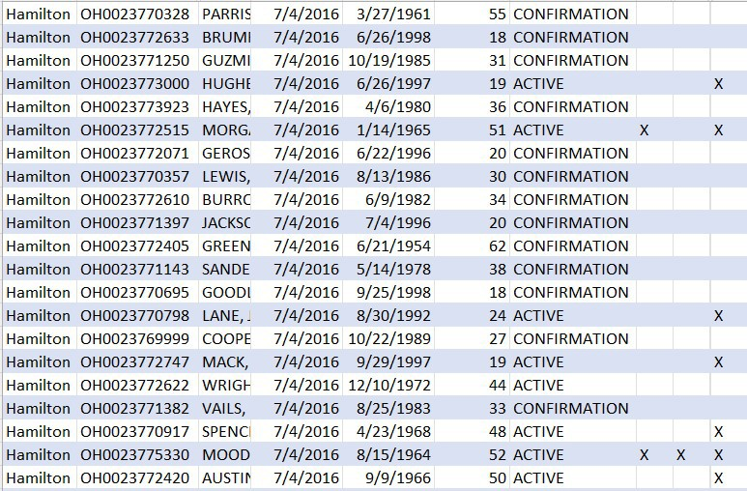
DATA INCONSISTANT WITH SOS DIRECTIVES:

Slide 90
Very specific data entry standards and instructions are provided in the Ohio Elections Manual, for example: no special characters are to appear in a Name.
Modern ‘best practices dictate that software prevent the entry of any data which violates a rule and it is evident the software used to maintain the voter registration system has not been designed or developed to accommodate these practices.
Even the most basic software validation rules don’t exist, such as a Registration Date may not be before the Date of Birth.
The following screens demonstrate these issues.
OEM Section 4.06 Data Entry Standards: County boards of elections must adhere to the data entry standards contained in this Section when entering information into the SWVRD. Additionally, each board of elections must review its existing records in the SWVRD and make any and all changes necessary to comply with the data entry standards outlined in this Section. By having data in a standardized format, boards will be able to identify additional duplicate records and obtain more accurate results when searching for a voter’s information in the SWVRD.
DATE INTEGRITY ISSUES:
90 | P a g e

Slide 91
49 voters are at least 114 years old, 25 voted in Nov 2020
6 voters voted before they were born
735 persons voted in a general election prior to 18th birthday
58,483 voters have a registration date of 1/1/1900
56,831 in Active status, 55,143 voted Nov 2020
48,790 voted Nov 2022
223 registered before their birth date (214 on 8/2022, 200 12/2022)
204 in Active status, 171 voted in Nov 2020
253 voters registered prior to 11/3/2020 but are 18 after 11/3/2020
th
1,764 voters registered before their 17 birthday (1749 on 8/20/22)
Really Old People are Still Voting in Ohio

Slide 92
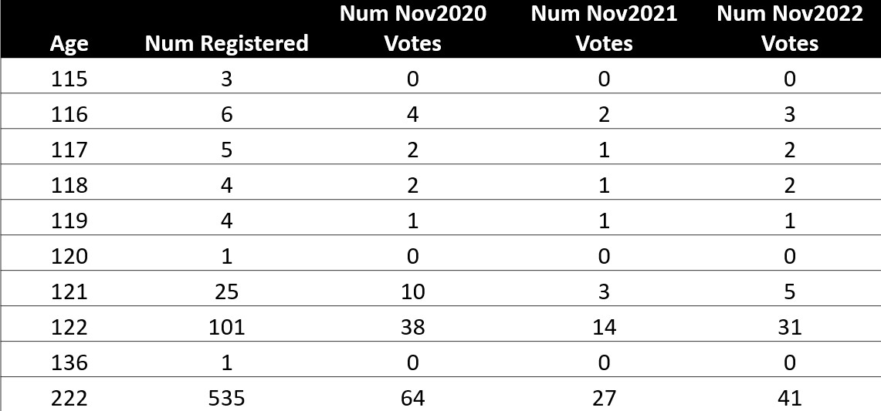
Jan 1 1800 Date of Birth

Slide 93
There are various voter registration records with 1/1/1800 data of birth, and many of them vote. This date of birth exists on registration records as recent as 2022.
Why does Ohio Revised Code allow provisional ballots to be counted with a date of birth of 1/1/1800?
ORC Section 3505.183 (B)(3)(e ) Except as otherwise provided in this division, the month and day of the elector’s date of birth are not different from the day and month of the elector’s date of birth contained in the statewide voter registration database. This division does not apply to an elector’s provisional ballot if the following is true:
(i) The elector’s date of birth contained in the statewide voter registration
database is
January 1, 1800.
Why does Ohio Elections Manual reference 1/1/1800 date of birth in the Section describing BMV Change of Address?
OEM Section 4.09 Bureau of Motor Vehicles Change of Address: DOB Is Invalid in the SWVRD Record, and the Record Pairs Match Exactly on BMV ID, SSN4 and Last Name For every BMV-SWVRD matched record in which the SWVRD DOB field is “1/1/1800,” and the two records match exactly on BMV ID, SSN4, and Last Name (regardless whether the records match on First Name), board staff must immediately complete the voter’s record in the county voter registration system and the SWVRD with the DOB from the field labeled BMV_DOB.
Voter Registration Records with 1/1/1800 Date of Birth

Slide 94
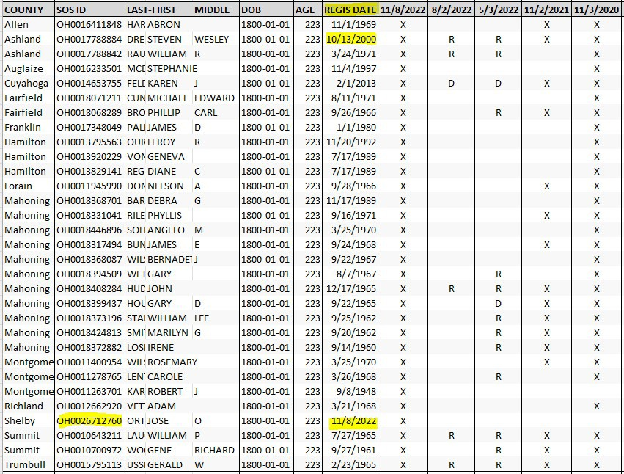
Jan 1 1800 and Jan 1 1900 Date of Birth

Slide 95
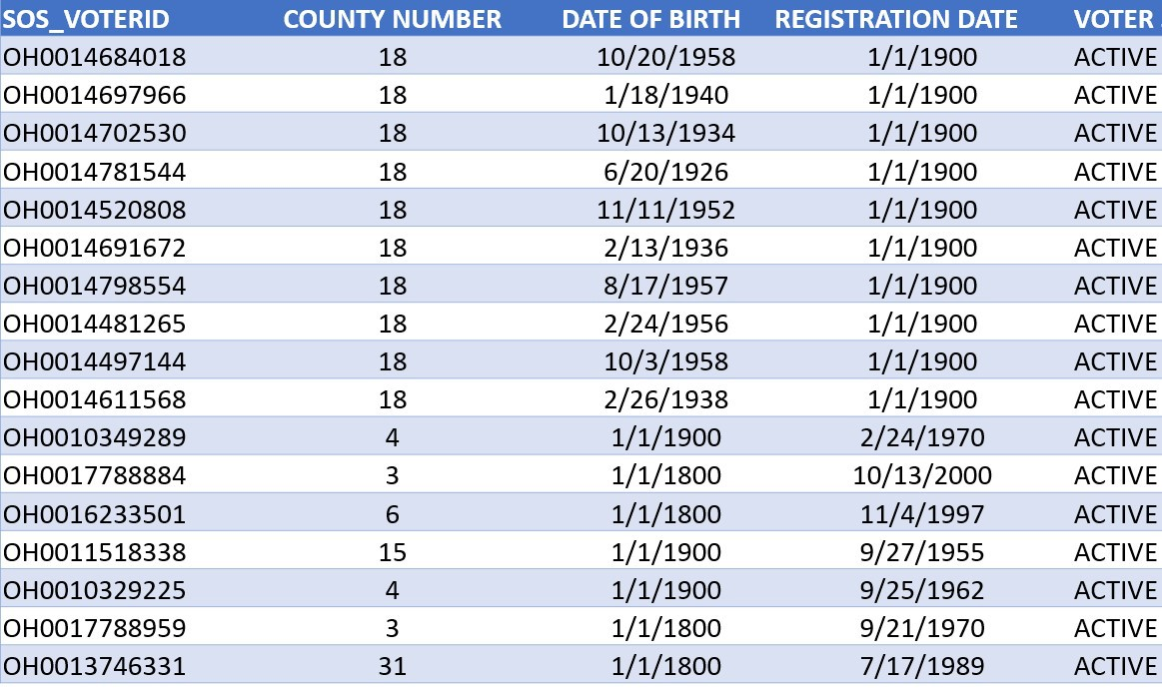
Jan 1 1900 Registration Date
Registration Date Before Date of Birth

Slide 96
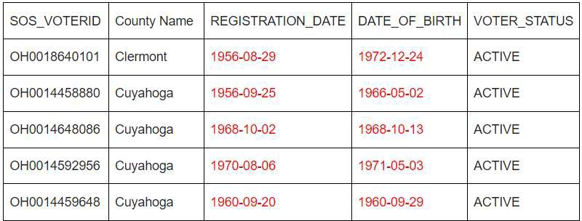
Nicknames that could cause Duplicate Registrations

Slide 97
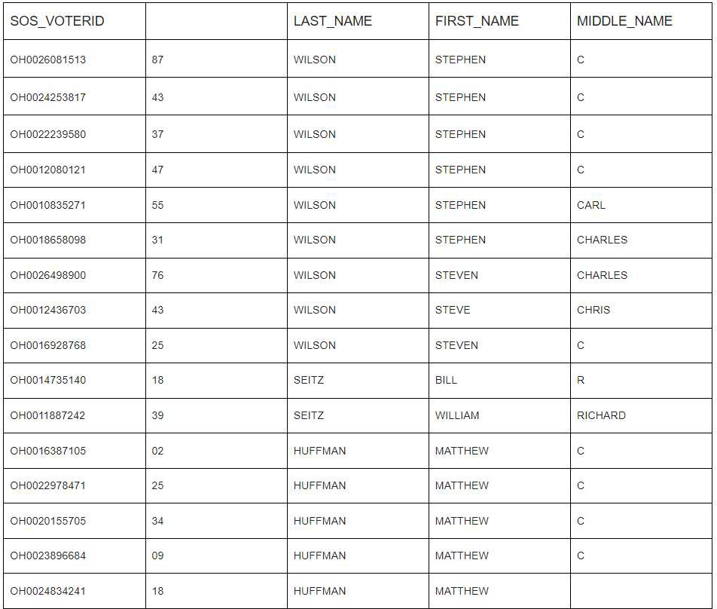
Full Legal Name that matches ID should be required on Voter Rolls
NAMES WITH UNALLOWED CHARACTERS

Slide 98
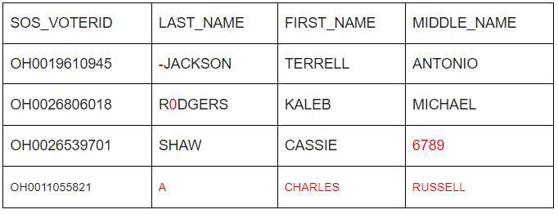
11,336 voter records with unallowed characters in the last name
1,147 instances use 78 different invalid suffixes
0314, \, Ann, B, C, DVM, ESQ, DR, DEAN, DDS, F, H,
and many others
3,498 instances of non-alphabetic characters in names
Cy ., Gregory A 9801033, Donna R 7407741898, and lots of punctuation
Names With Unallowed Characters

Slide 99
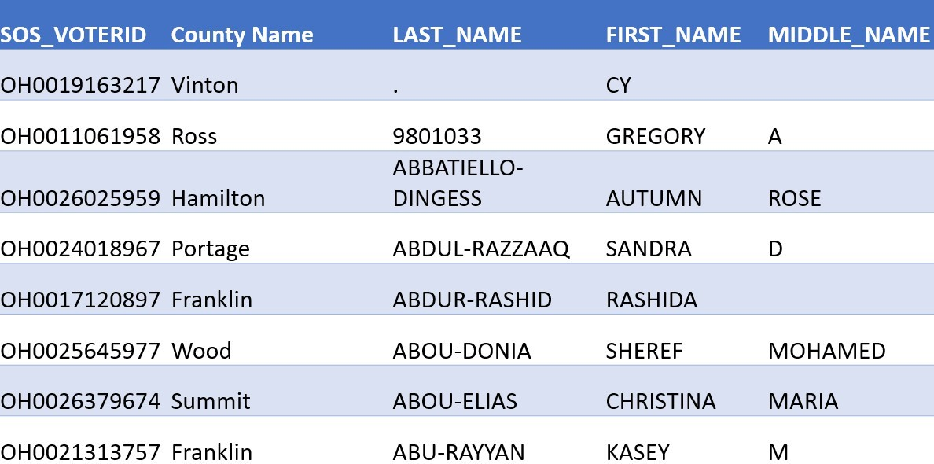
Names With Unallowed Characters

Slide 100
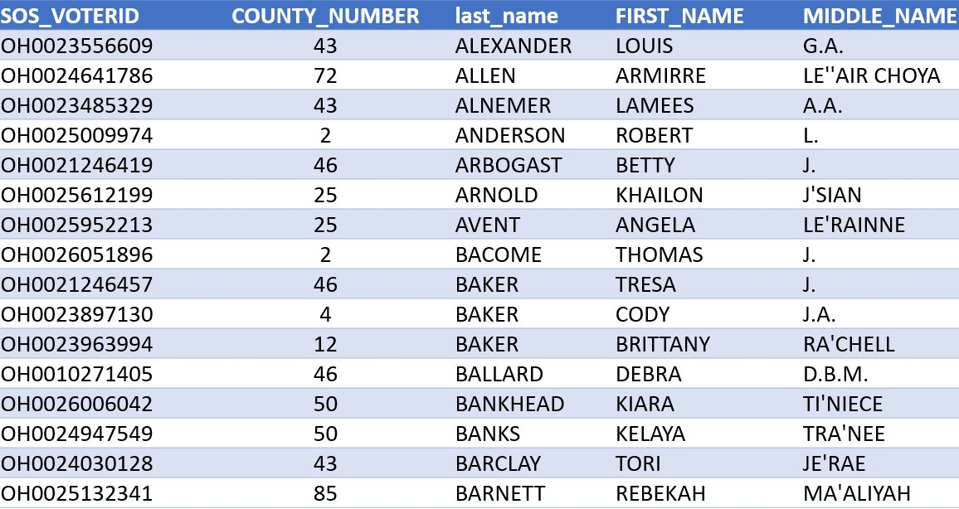
ADDRESS INTEGRITY ISSUES
100 | P a g e

Slide 101
4,970 records with unallowed characters in street addresses (4866 on 8/20/22, 4939 on 12/26/22)
19,738 records use secondary indicators that don’t follow USPS standards (11,061 on 8/20/22)
112,408 records use non-standard highway designations (112,291 on 8/20/22)
Lack of consistency in entering military and overseas addresses
Address issues could imply issues with how the BMV maintains address records
Convenience or Accuracy?

Slide 102
Over the past 30 years or more, our country’s lawmakers have changed our country’s elections systems to focus on making elections MORE CONVENIENT at the cost of ACCURACY.
Efforts to make voter registration and voting MORE CONVENIENT has made our country’s voter registration and election process more and more complicated, at the same time making it less secure.
This process has caused disenfranchisement of Ohio citizens.
Sometimes taking a look at history provides solutions for the future:

Slide 103
One Day Voting
with limited, legitimate exceptions
Paper Ballots Hand Count All Ballots
immediately following each election until all ballots are counted.
OHIO’s VOTER ROLLS REMAIN A MESS

Slide 104
There appears to be a limited emphasis placed on ensuring the accuracy
of registration information.
What will WE do?
Reach out to county Boards of Elections
We want to help counties clean their voter rolls.
IF NOT ME, THEN WHO?

Slide 105
If you are concerned with elections in Ohio and are interested in helping in our efforts to bring integrity to Ohio elections, please contact us on ohio4truth.com.
FOR MORE INFORMATION REGARDING ELECTIONS IN OHIO AND ACROSS OUR COUNTRY, VISIT

Slide 106
A special thanks to Allison, Jim, Don and the other volunteer citizen analysts who helped in providing the data for this presentation.
DISCLAIMER
This information is intended to enhance public understanding of government processes. This is a service that is continually under development. We believe the information presented to be timely and accurate, but we are fallible. We will make an effort to correct errors brought to our attention. Readers should be aware that the information described here may not reflect official positions of various government agencies and policy makers.

